Slide 1

BUILDING THE PLACES WHERE INNOVATION HAPPENS
LIZ BAMBER
DIRECTOR OF PLACE, SISTER

Slide 2
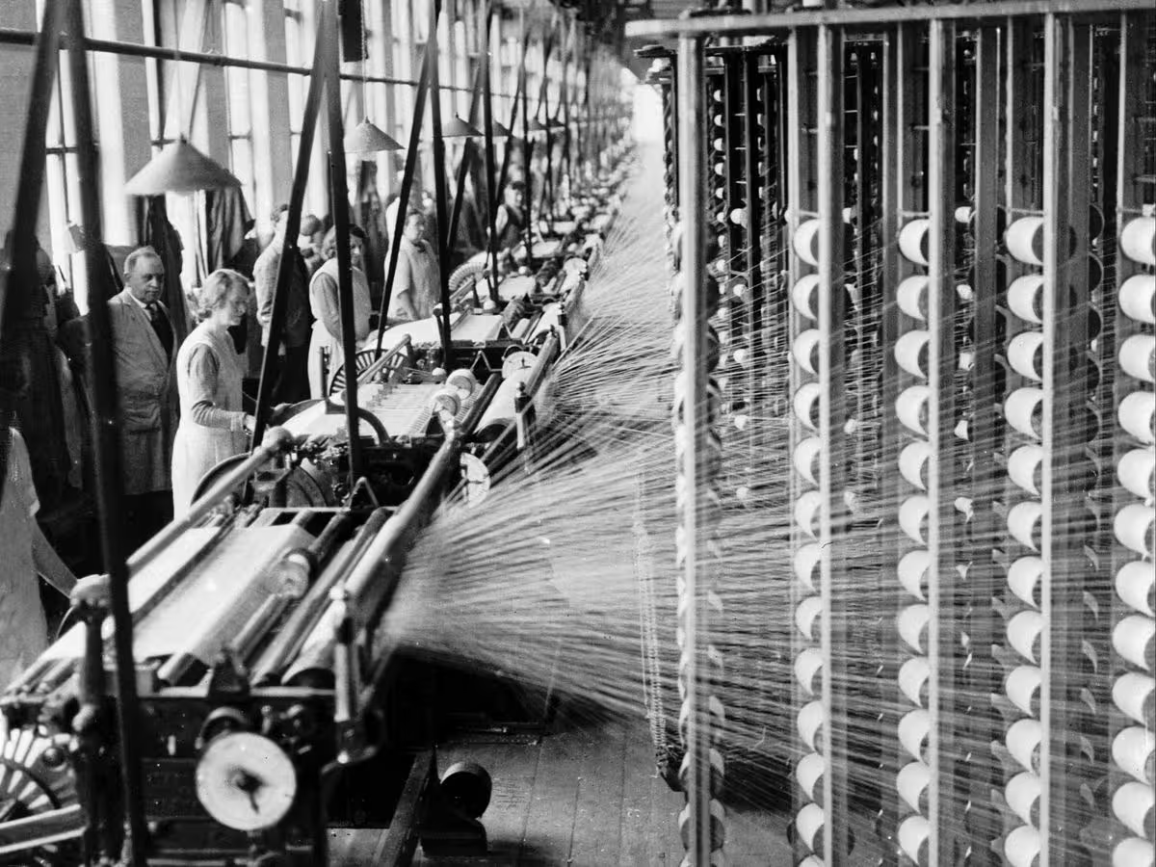
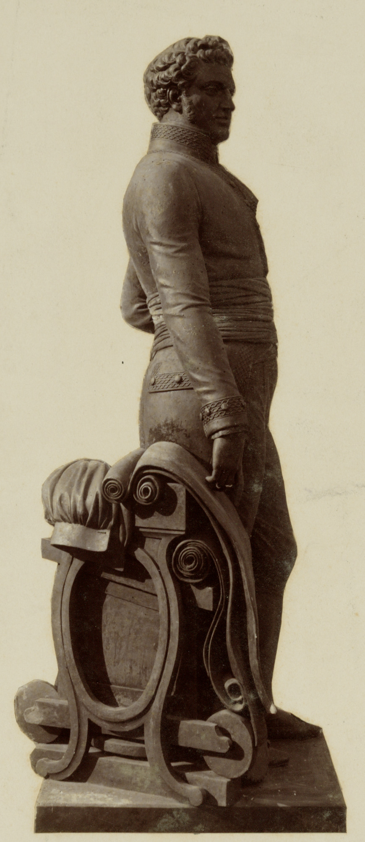
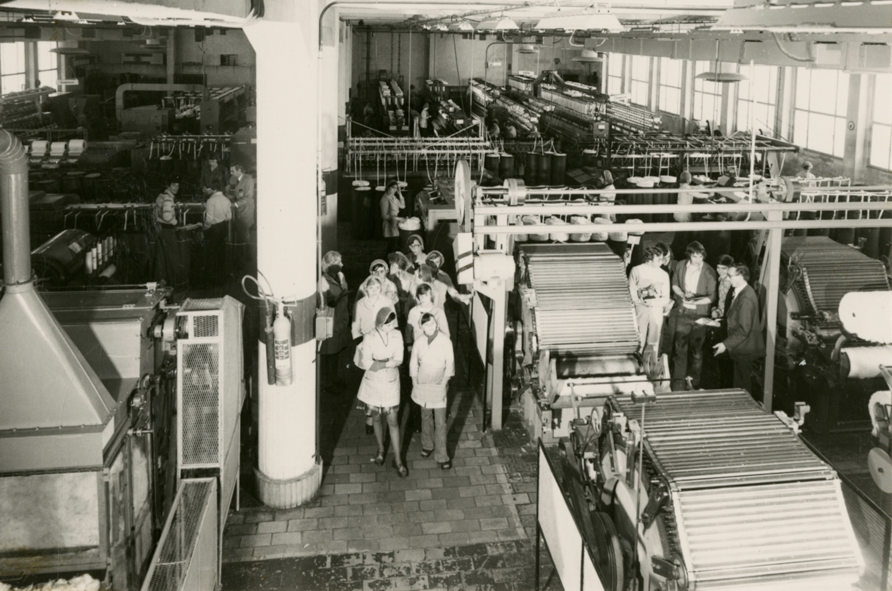
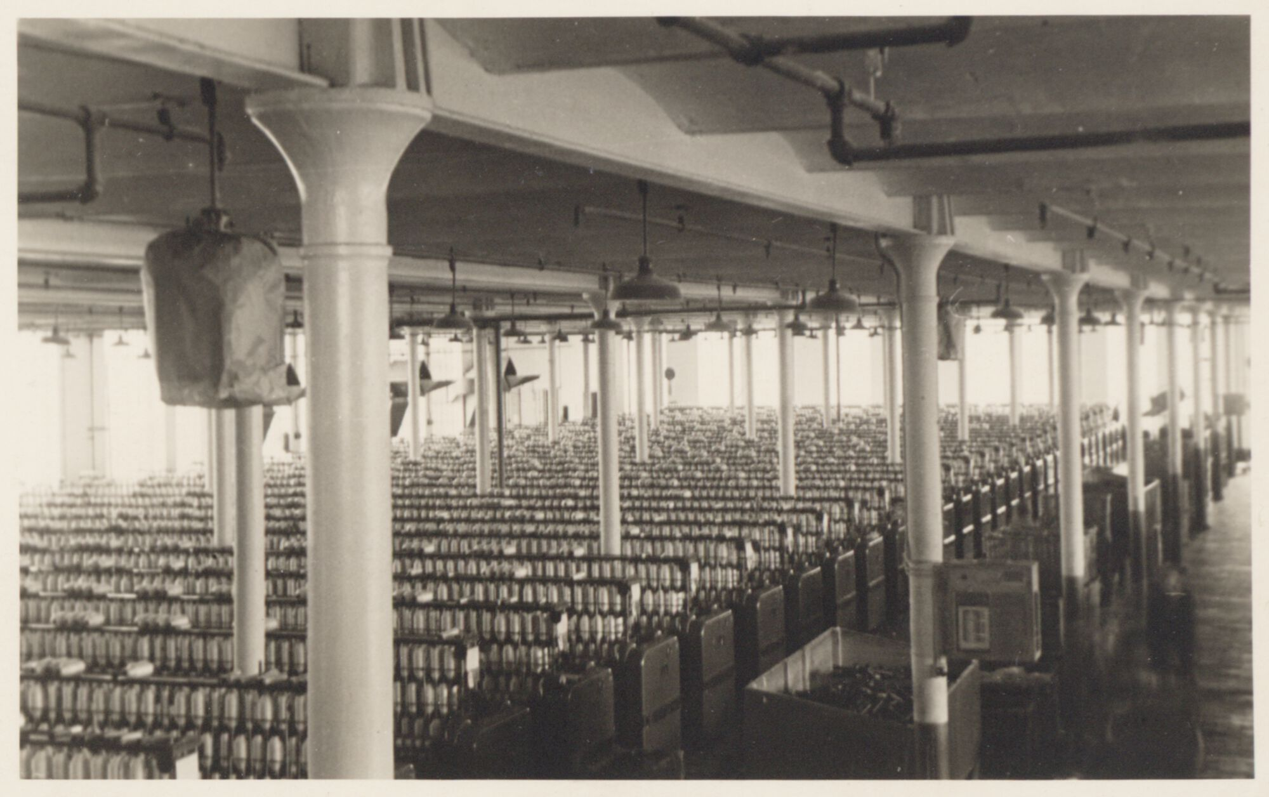
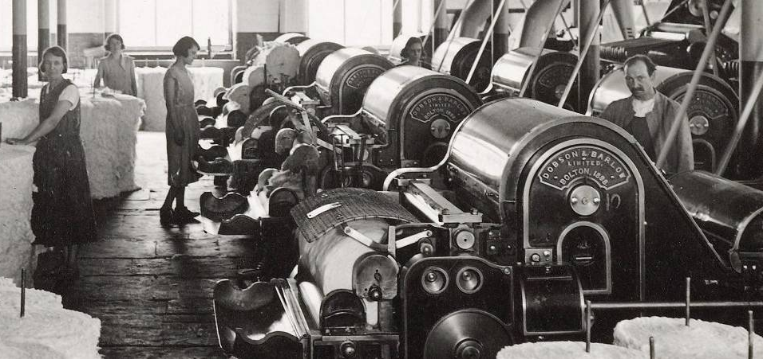
FROM MANCHESTER
TO GHENT

Slide 3
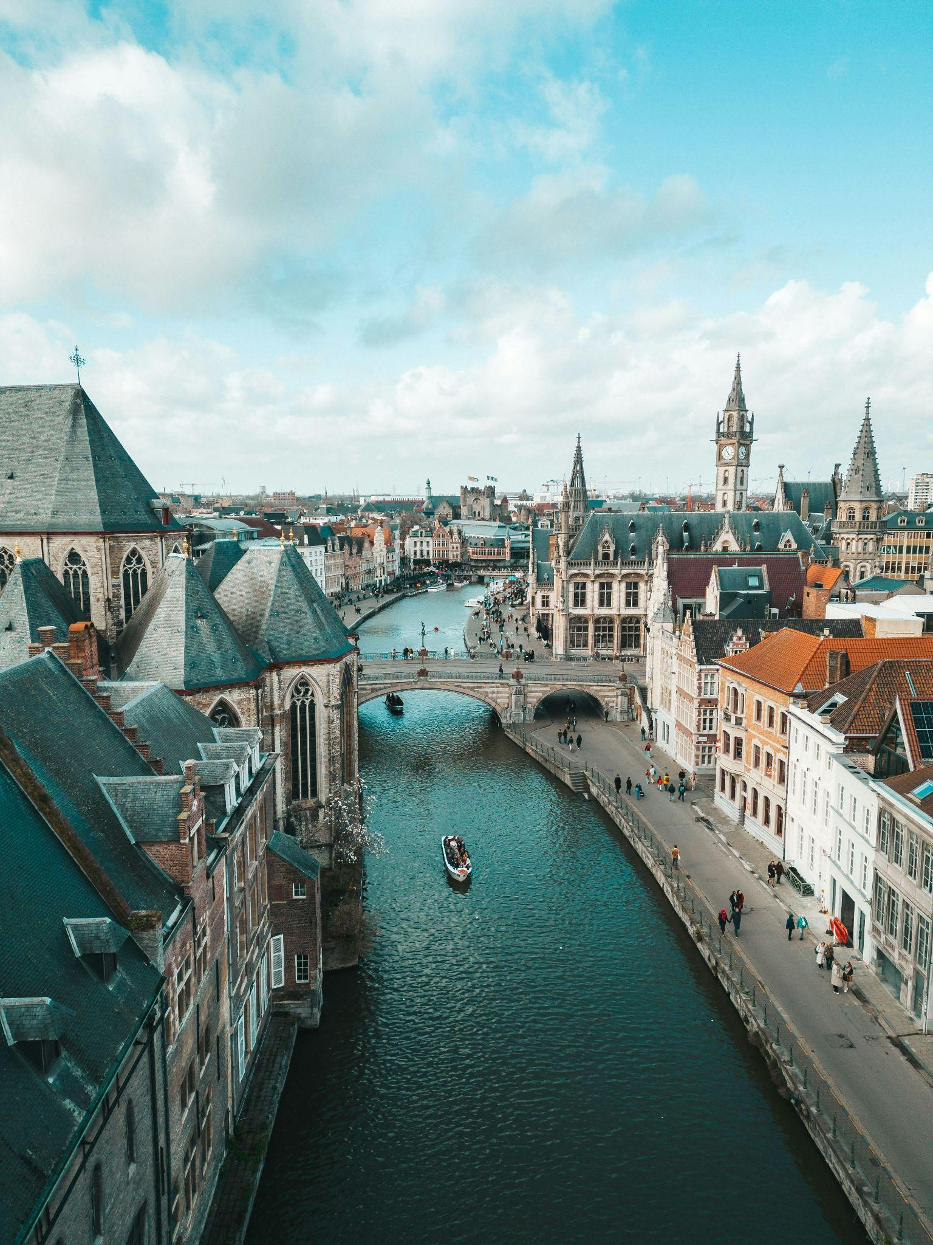
GHENT: A GLOBAL TECHNOLOGY CITY
10th Globally
4th in Europe
€61bn Technology Sector

Slide 4
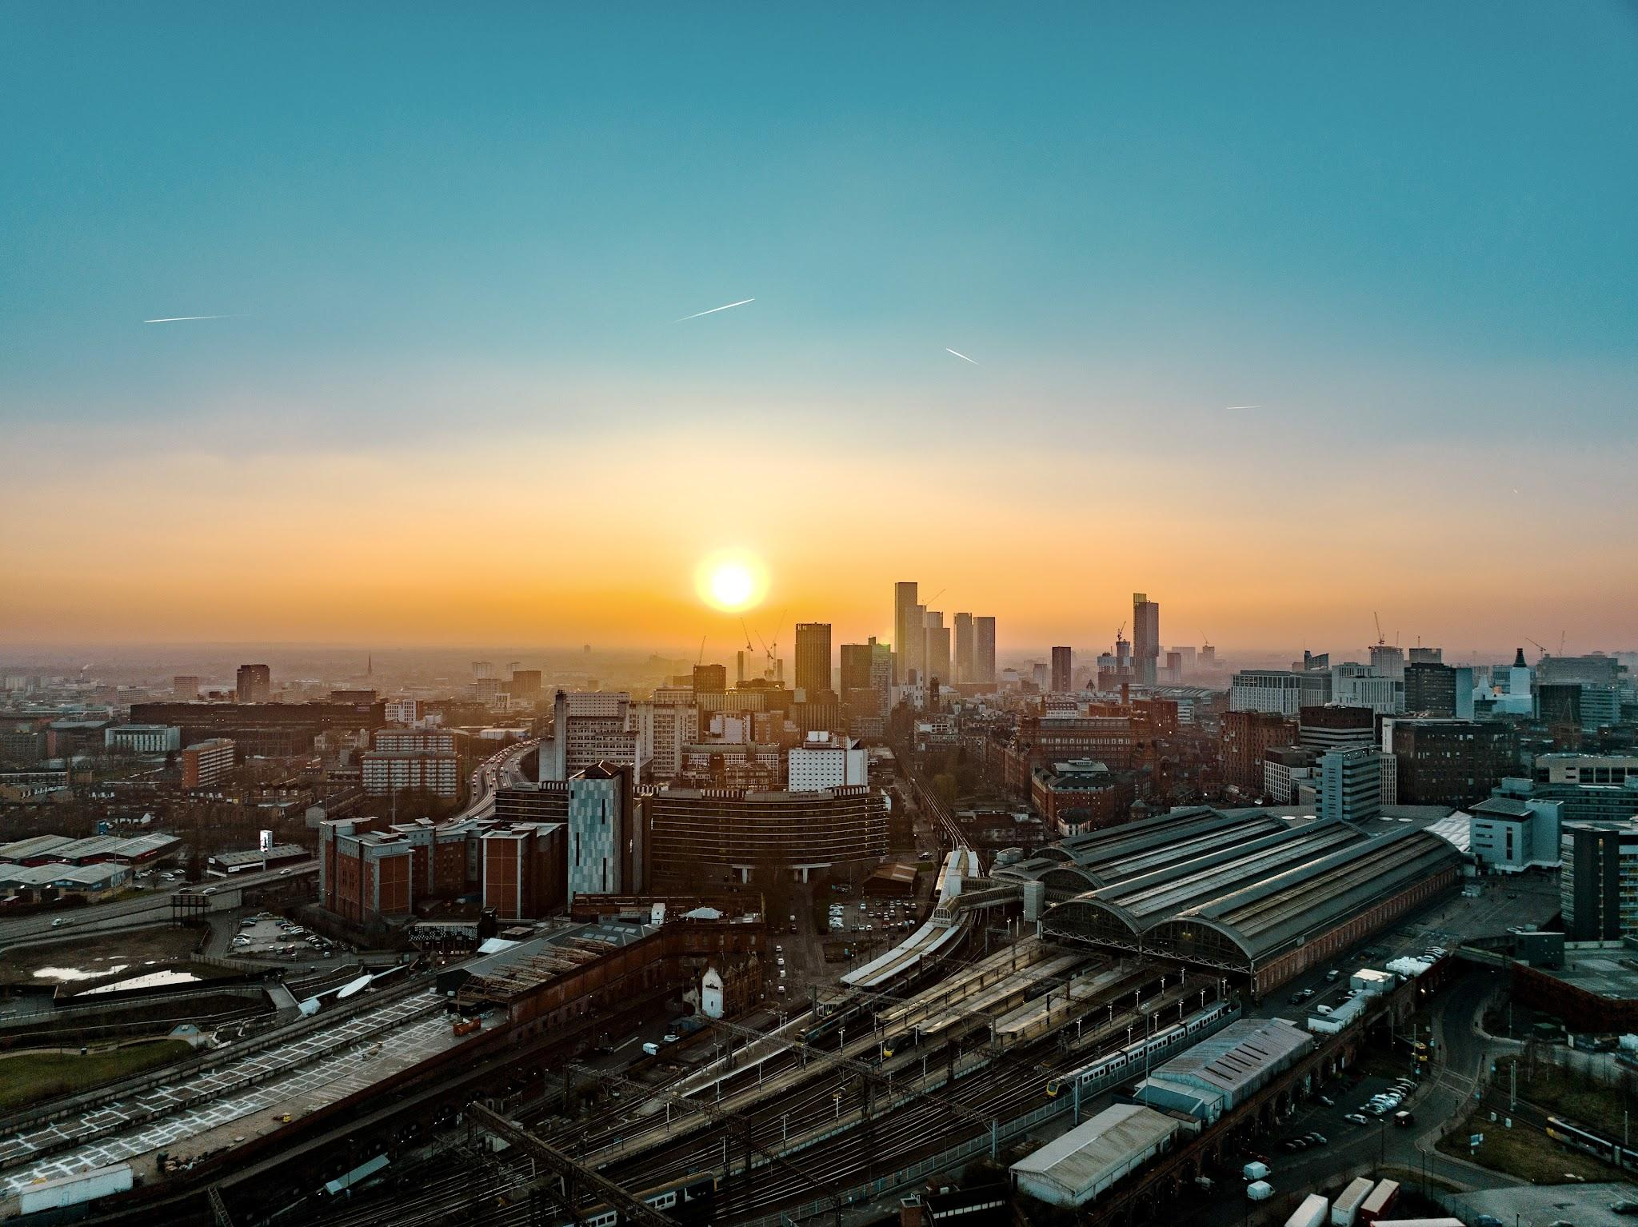
MANCHESTER: FROM INDUSTRIAL CITY TO TECH POWERHOUSE
100K city-centre residents
50% graduate retention rate
UK’s most livable city
Europe’s fastest growing tech city

Slide 5
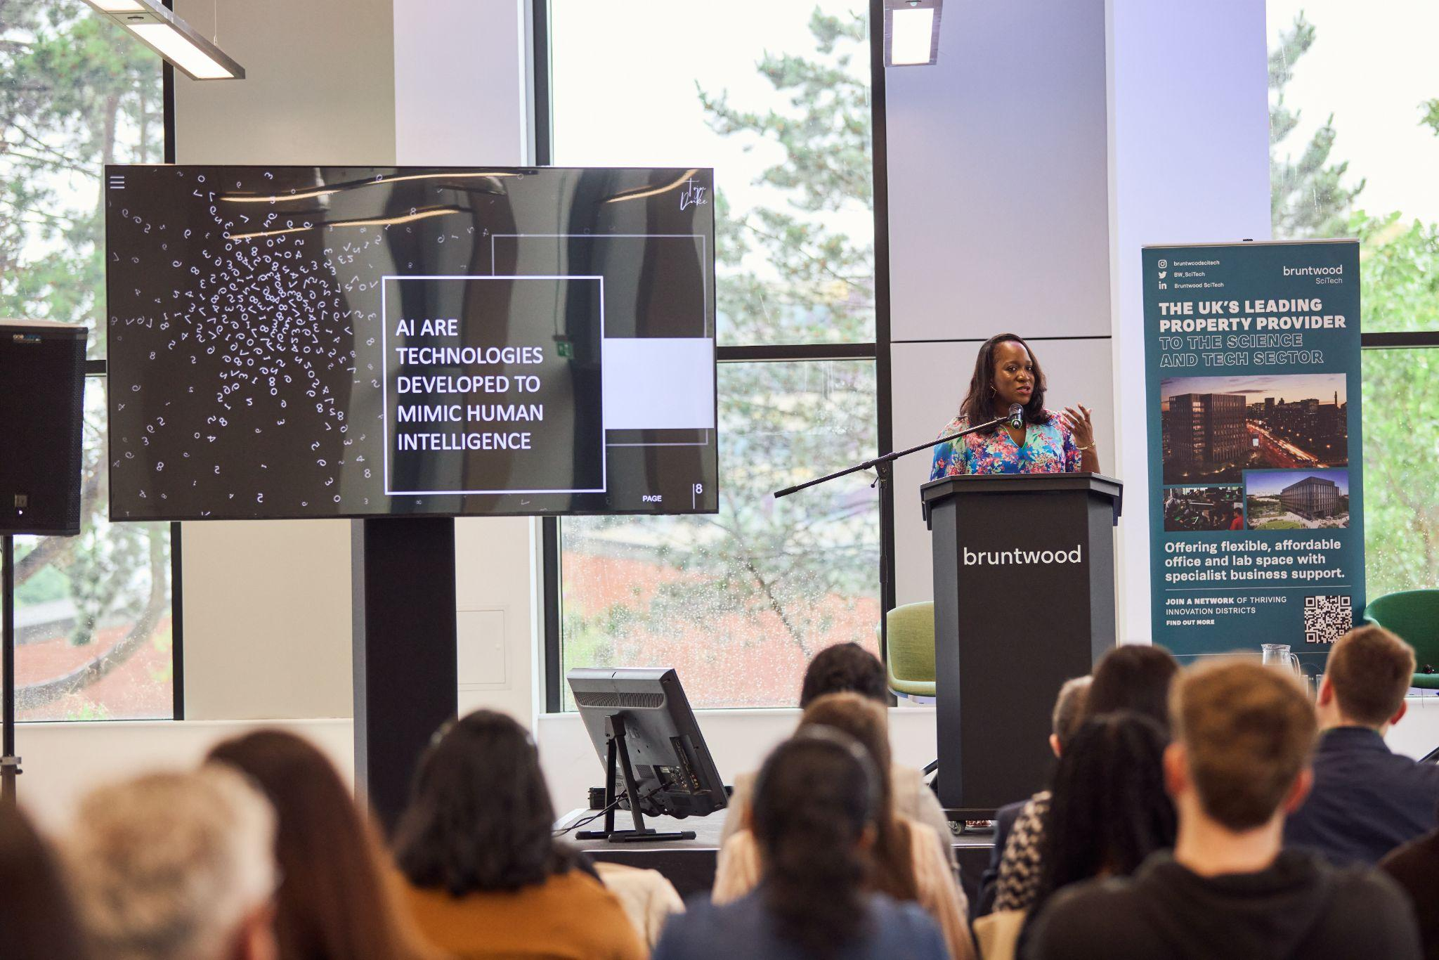
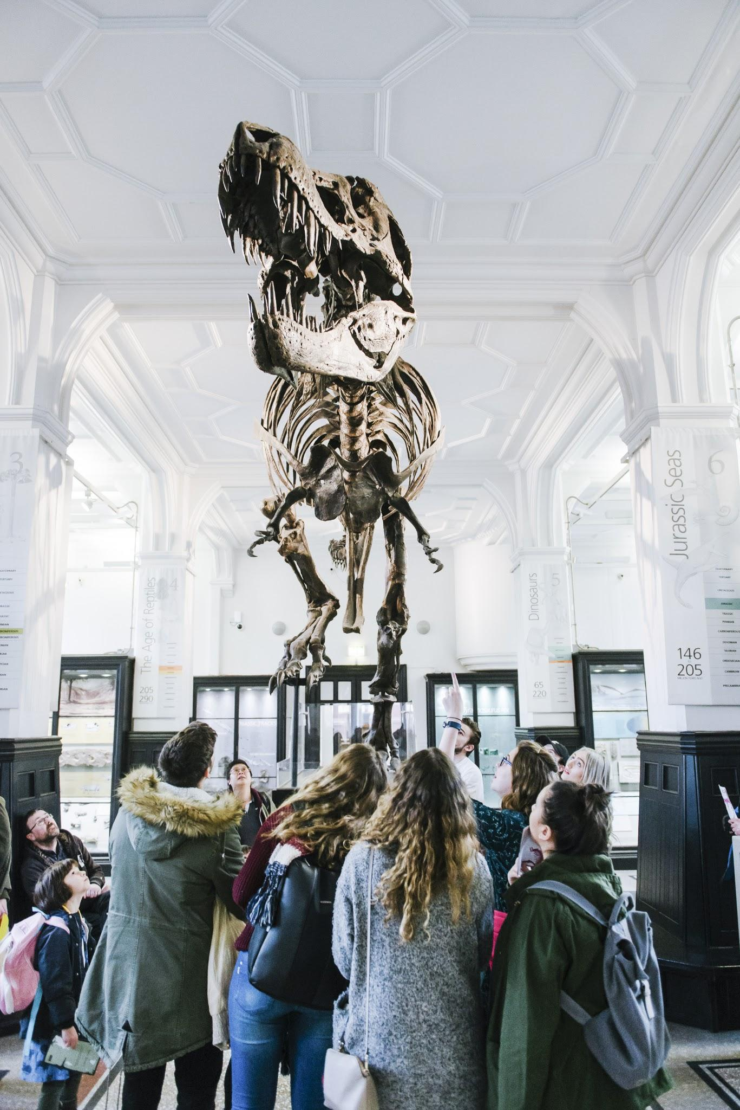
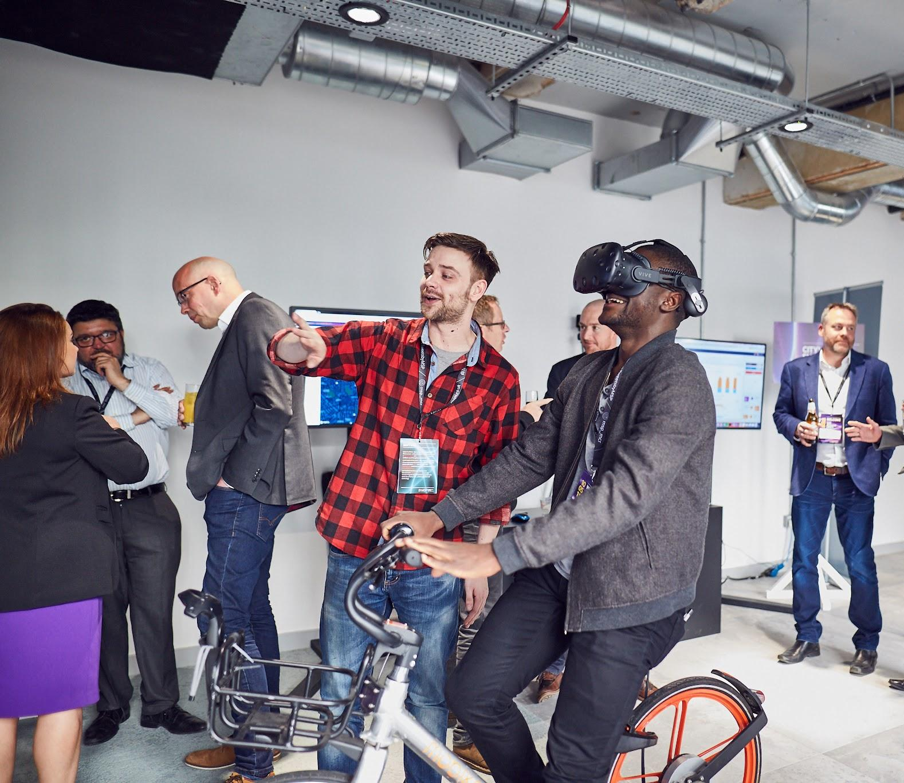
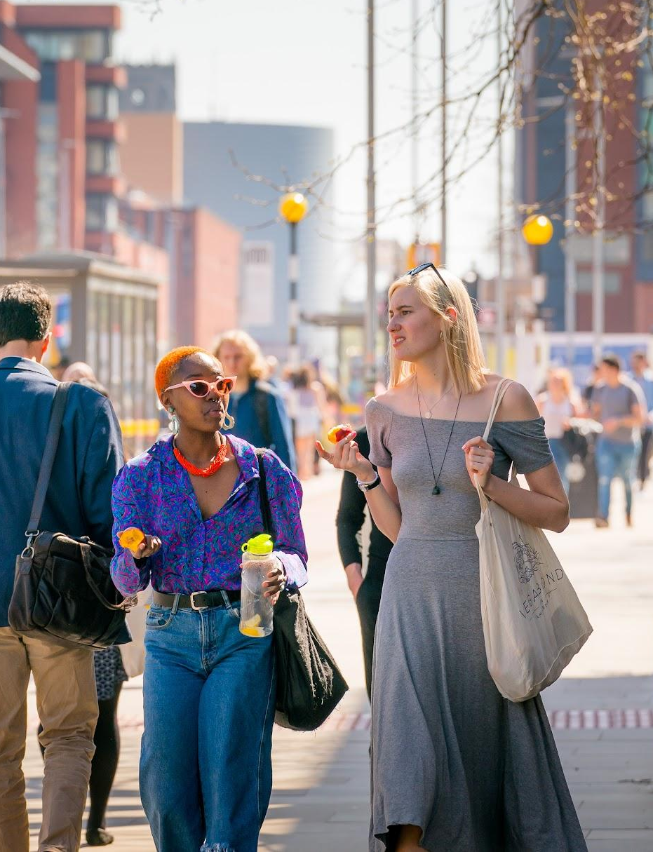
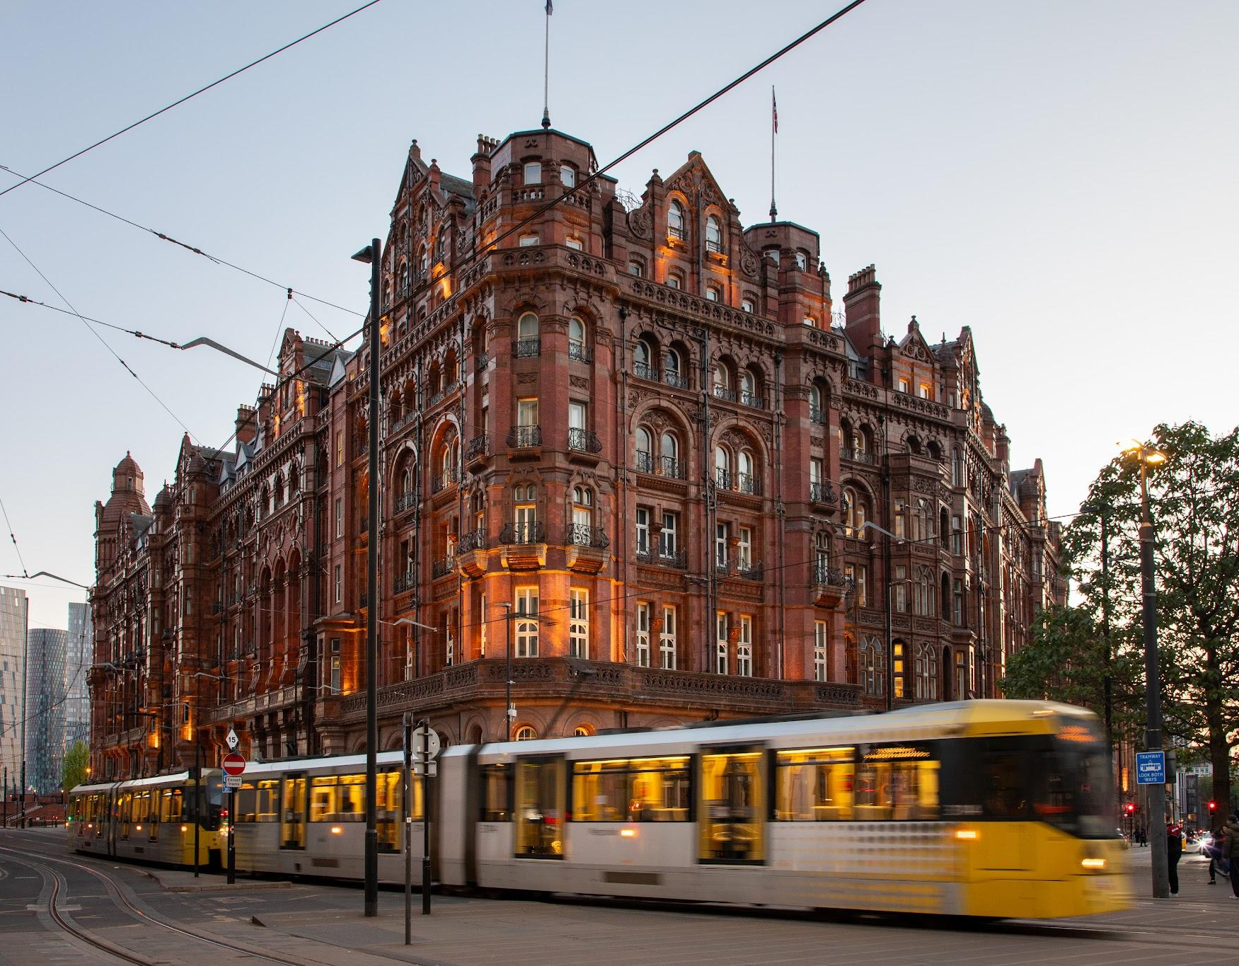
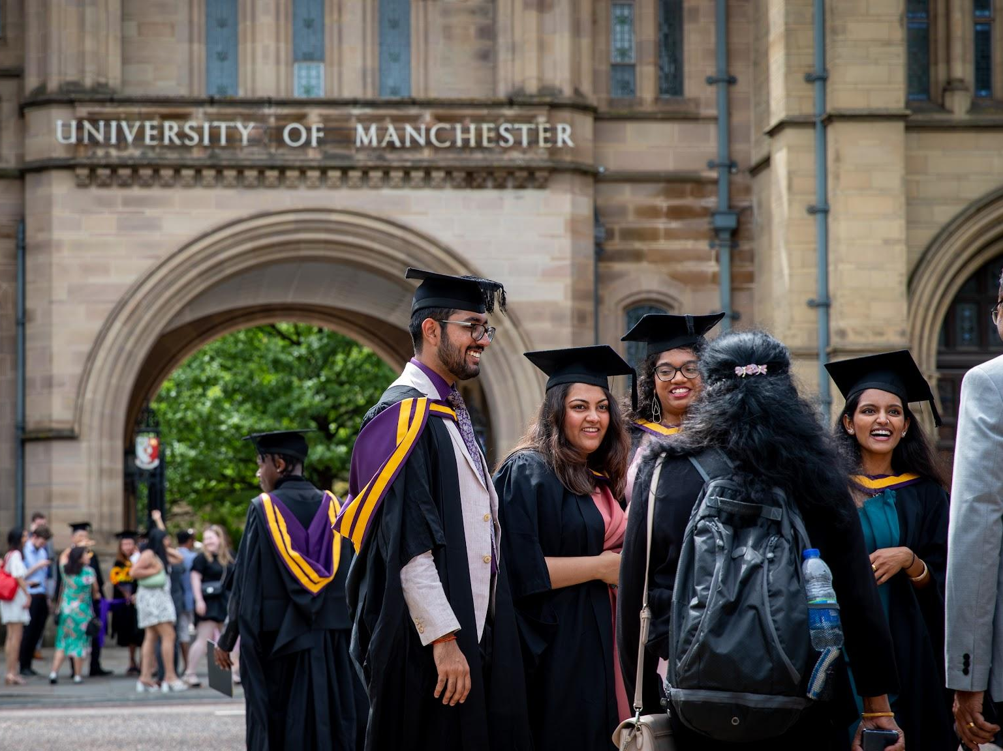

Slide 6
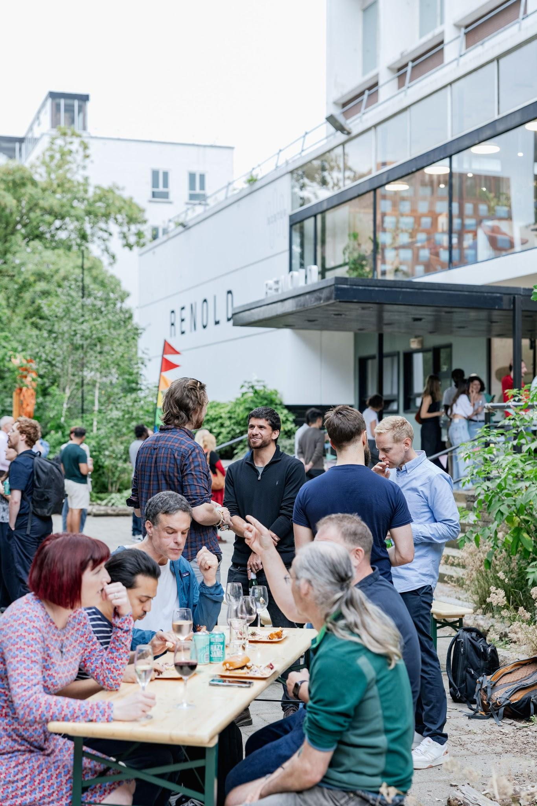
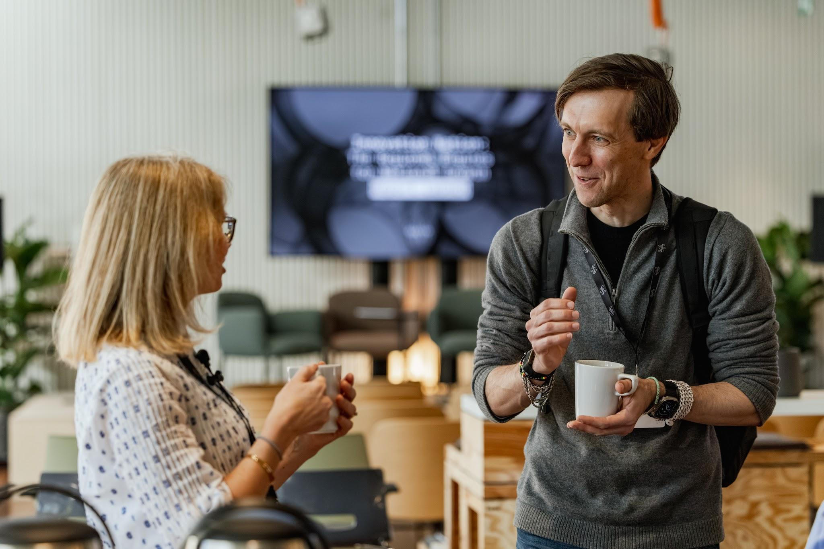
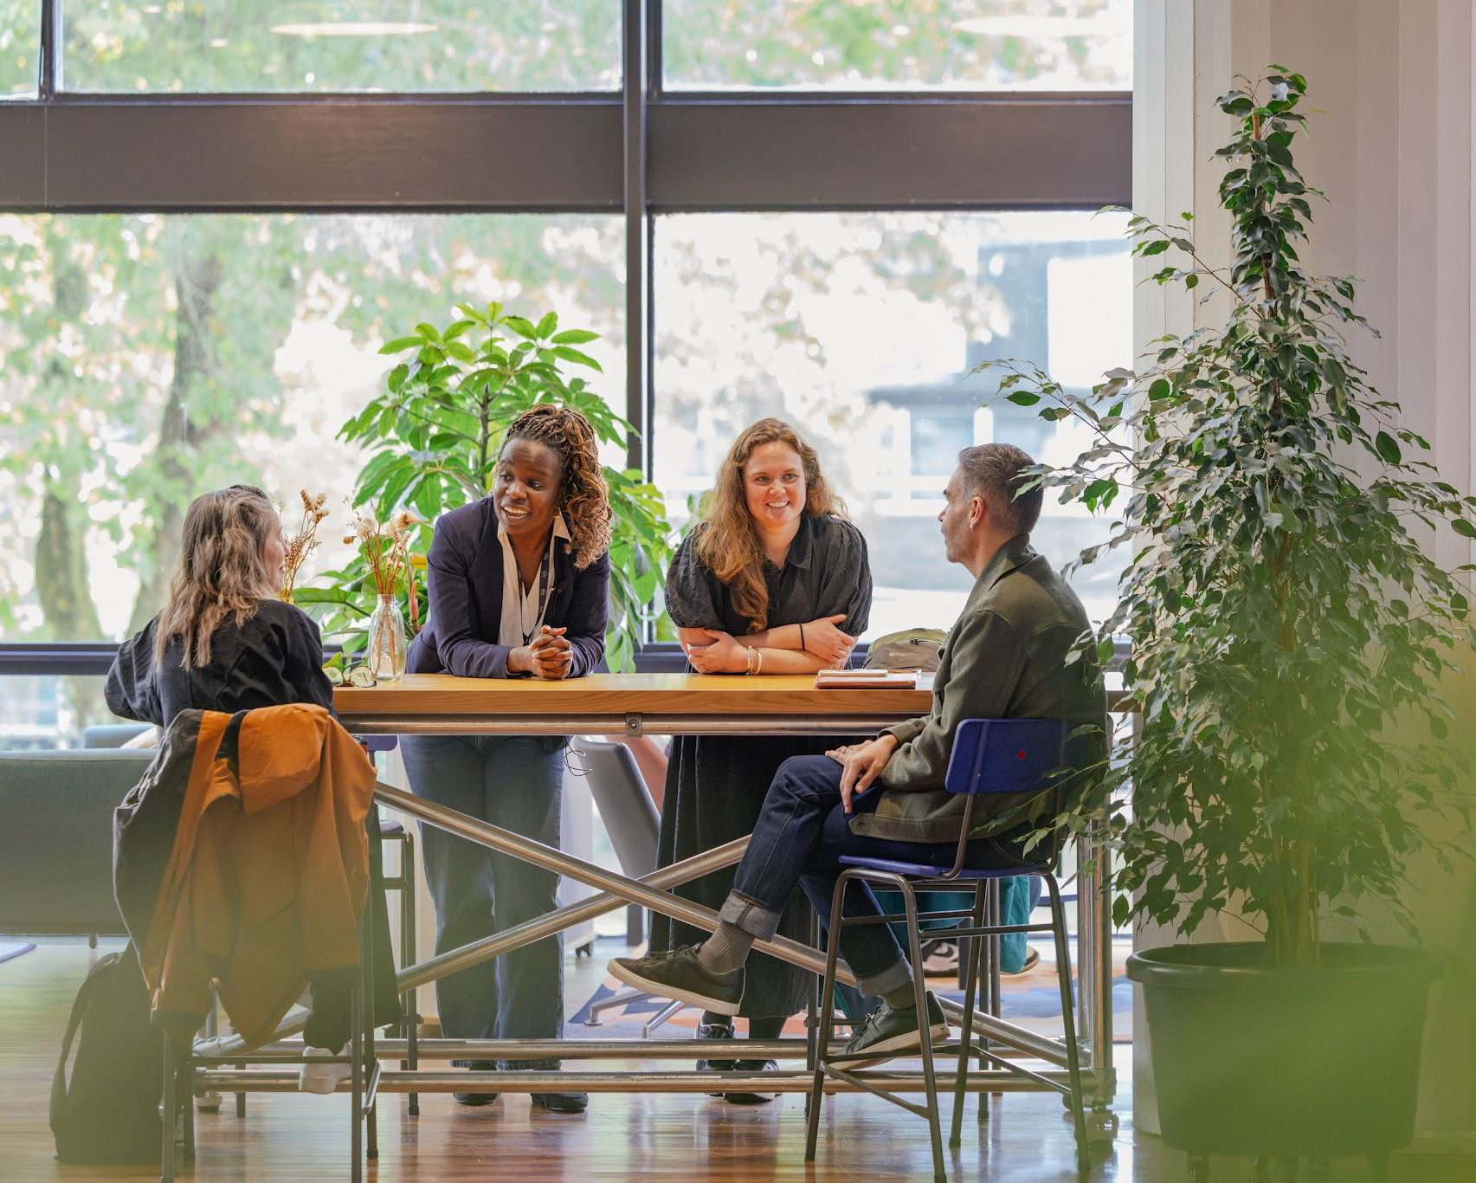
ENGINEERED SERENDIPITY
Meet
Connect
Collaborate
Innovate

Slide 7
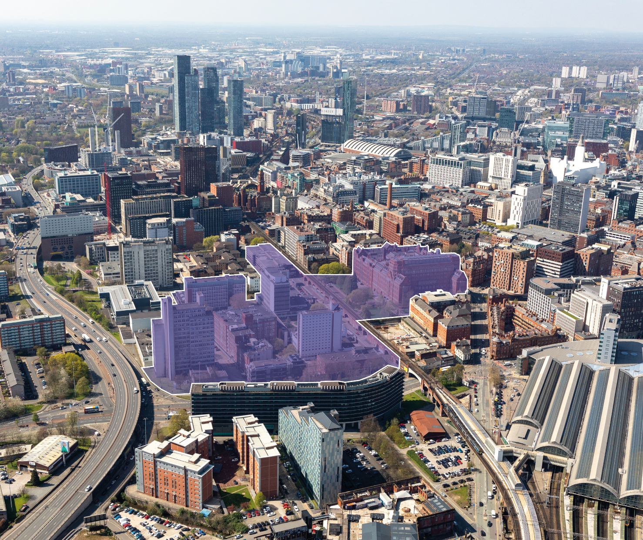

FROM ACADEMIC CAMPUS TO GLOBAL INNOVATION DISTRICT

Slide 8
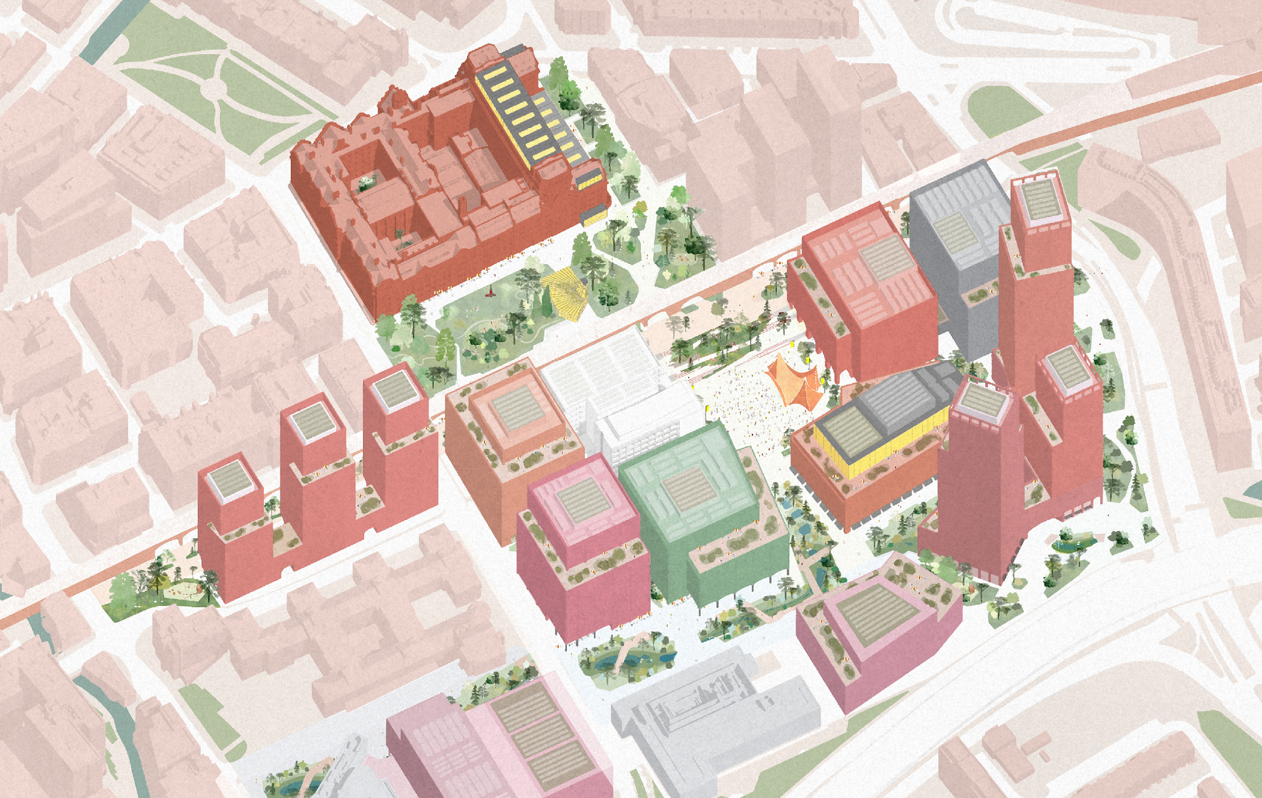
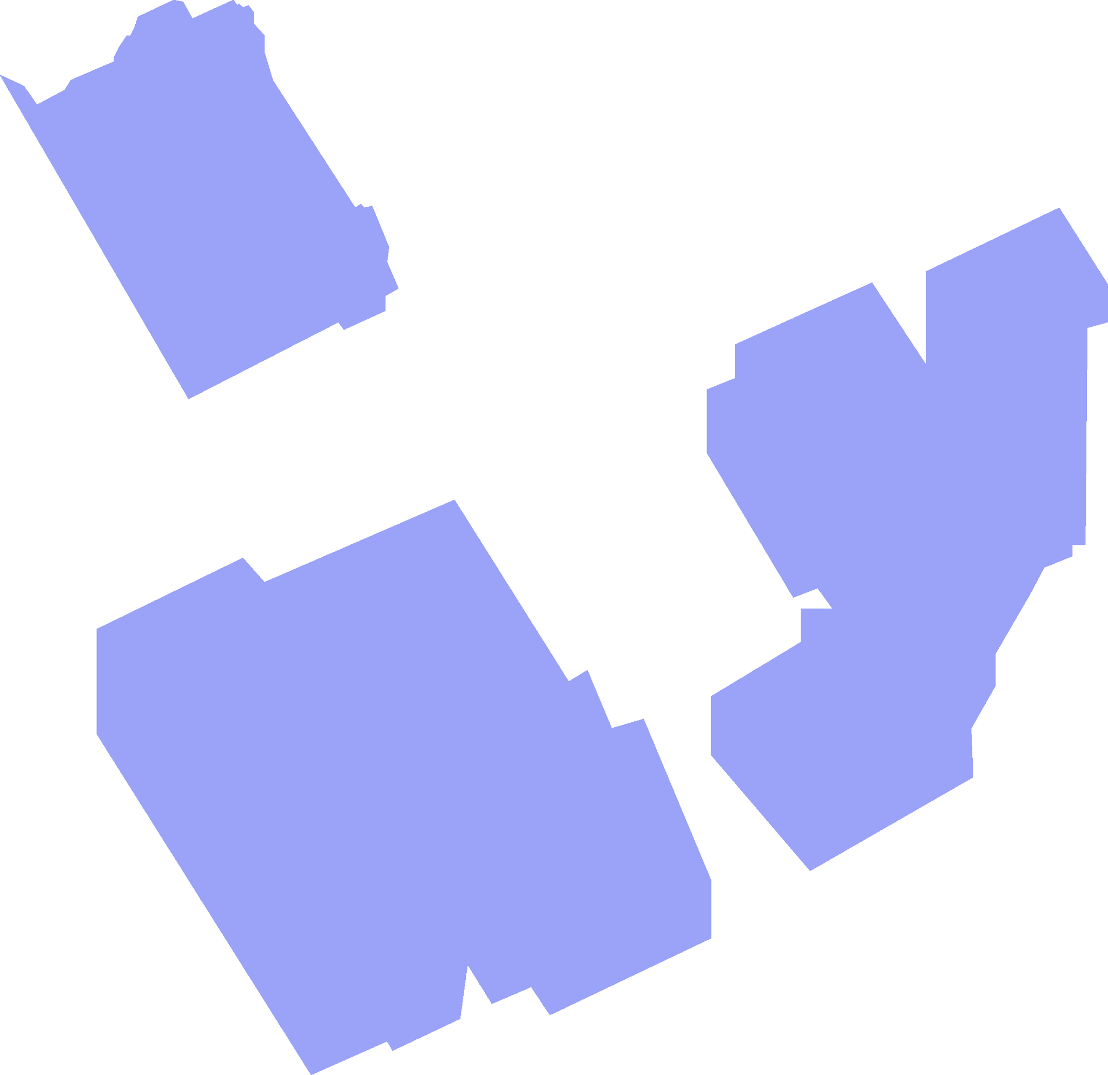



SISTER MASTERPLAN
4M sq ft
new city neighbourhood
Over 2M sq ft commercial space
More than 10,000 new jobs
Over 1,500
new homes
A new civic square for city-wide events
Reviving historic buildings
9 acres of public realm
Revitalised green spaces
OFFICE, LAB, RETAIL & LEISURE
RESIDENTIAL
HOTEL/RESIDENTIAL
PUBLIC REALM

Slide 9



Slide 10
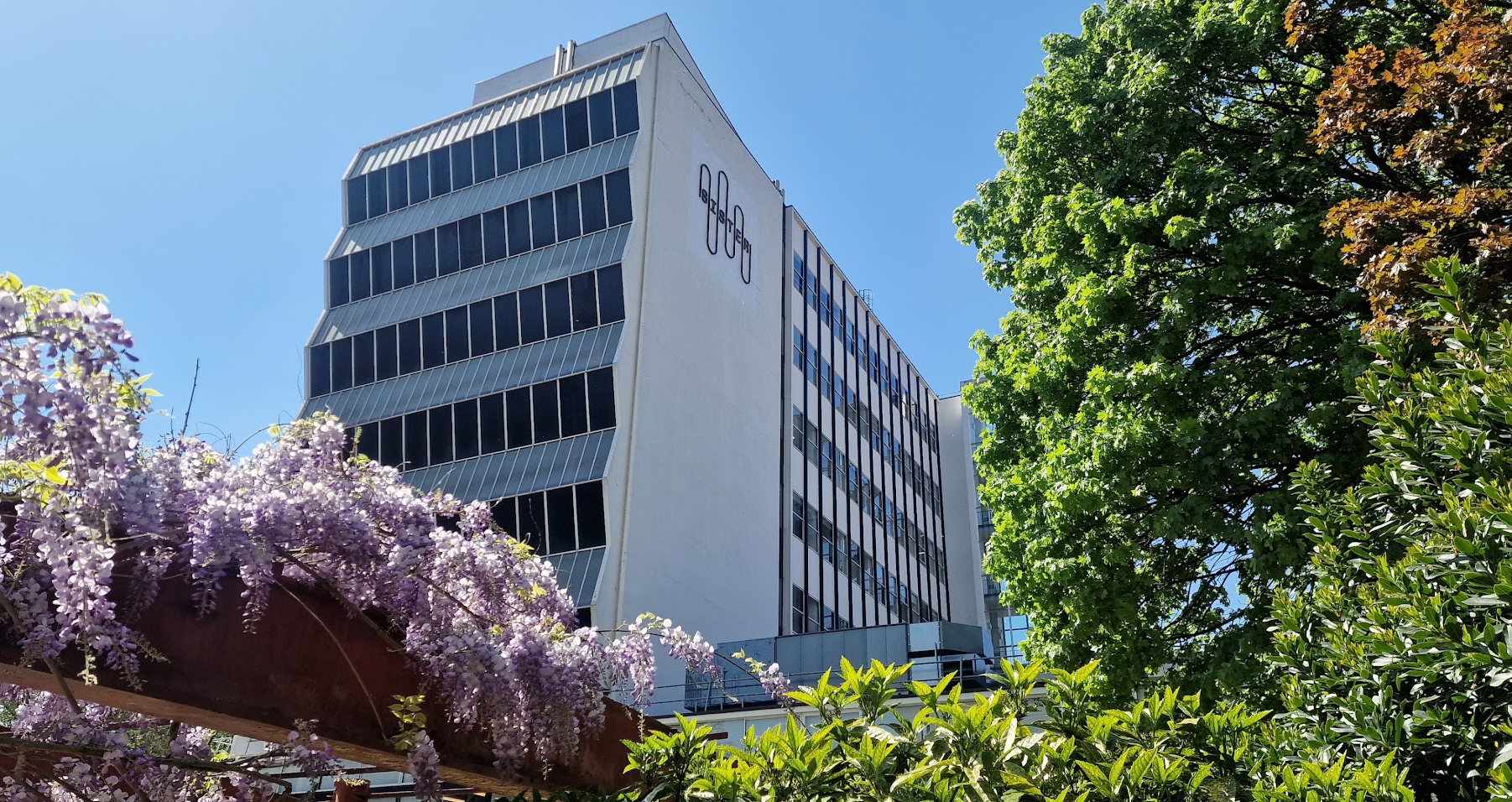
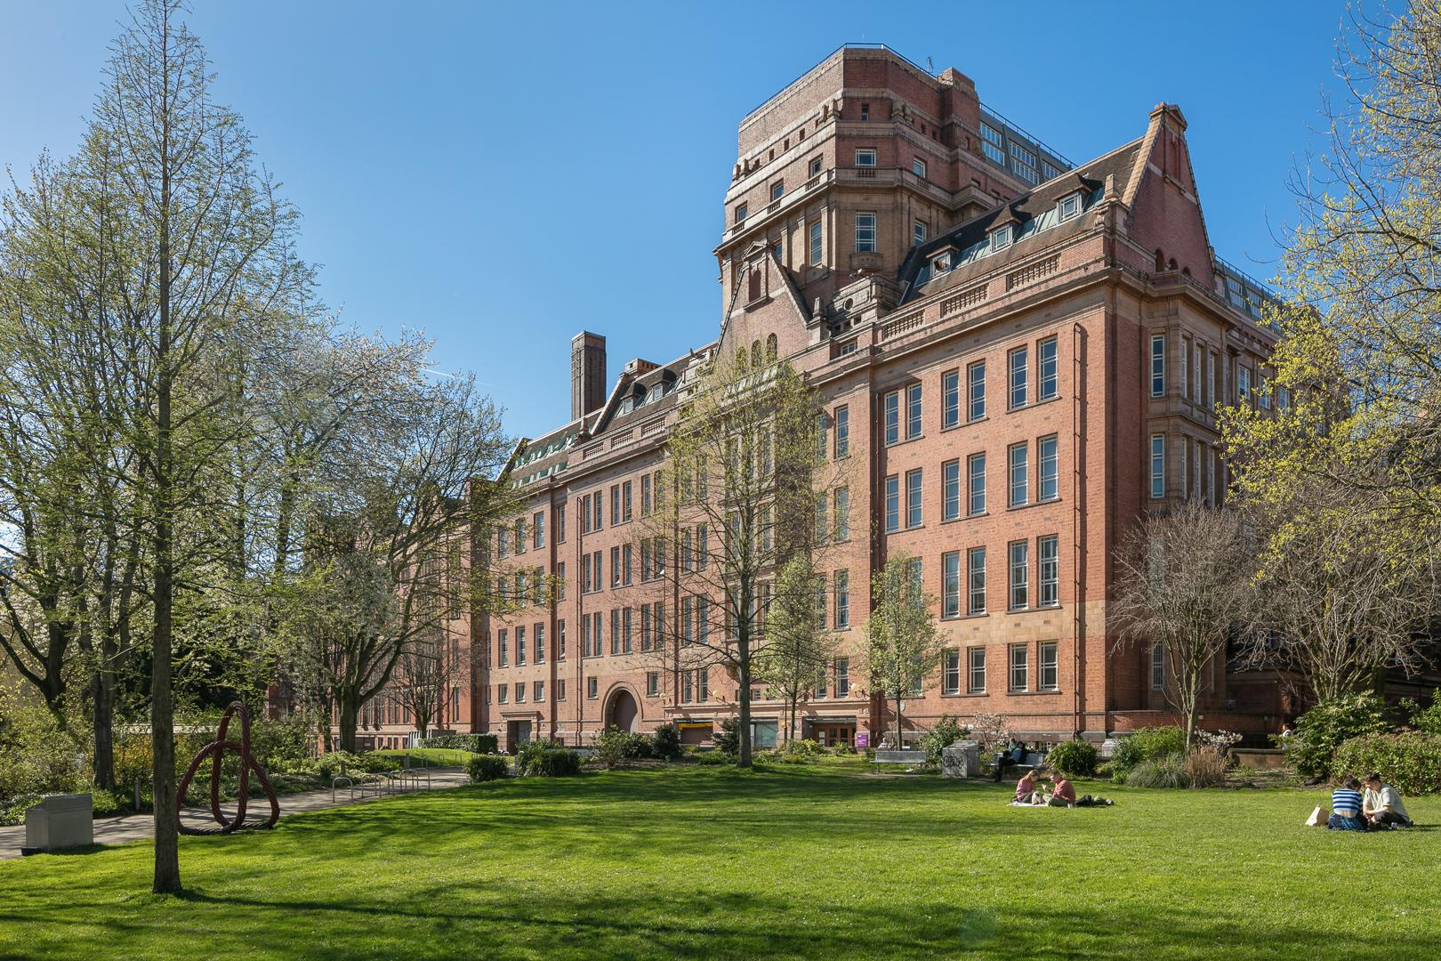
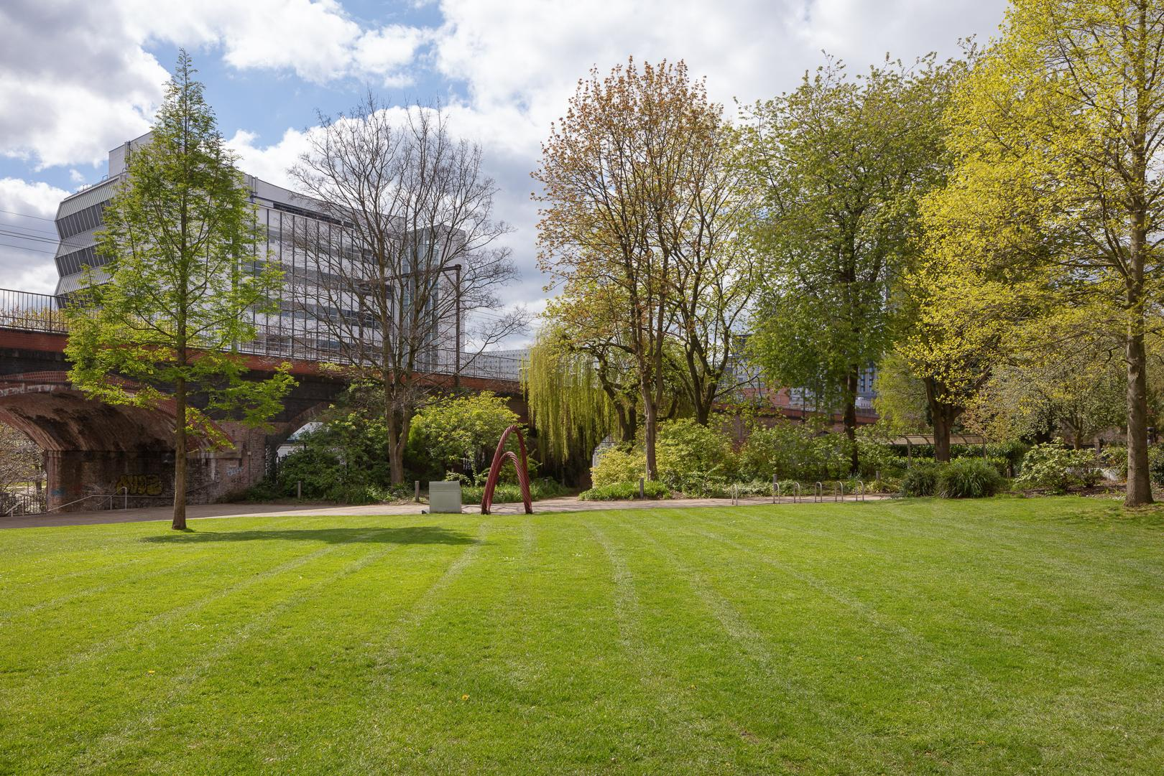
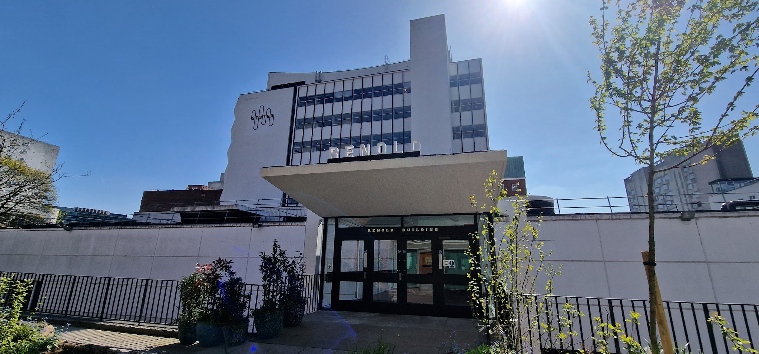

Slide 11
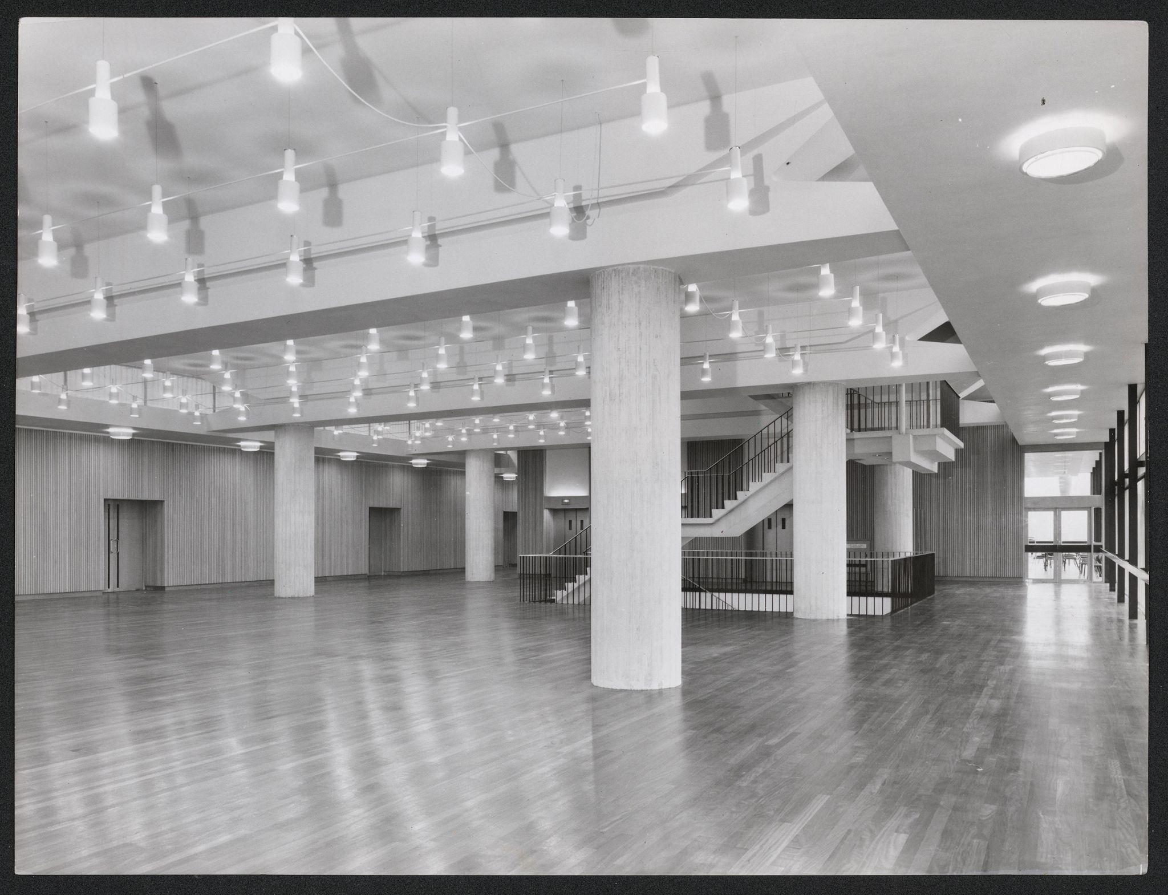
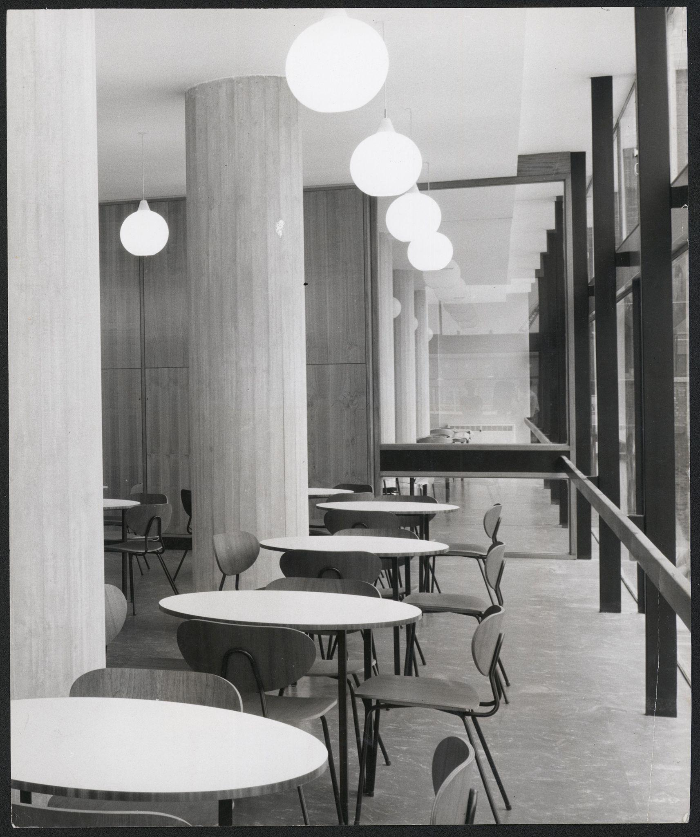
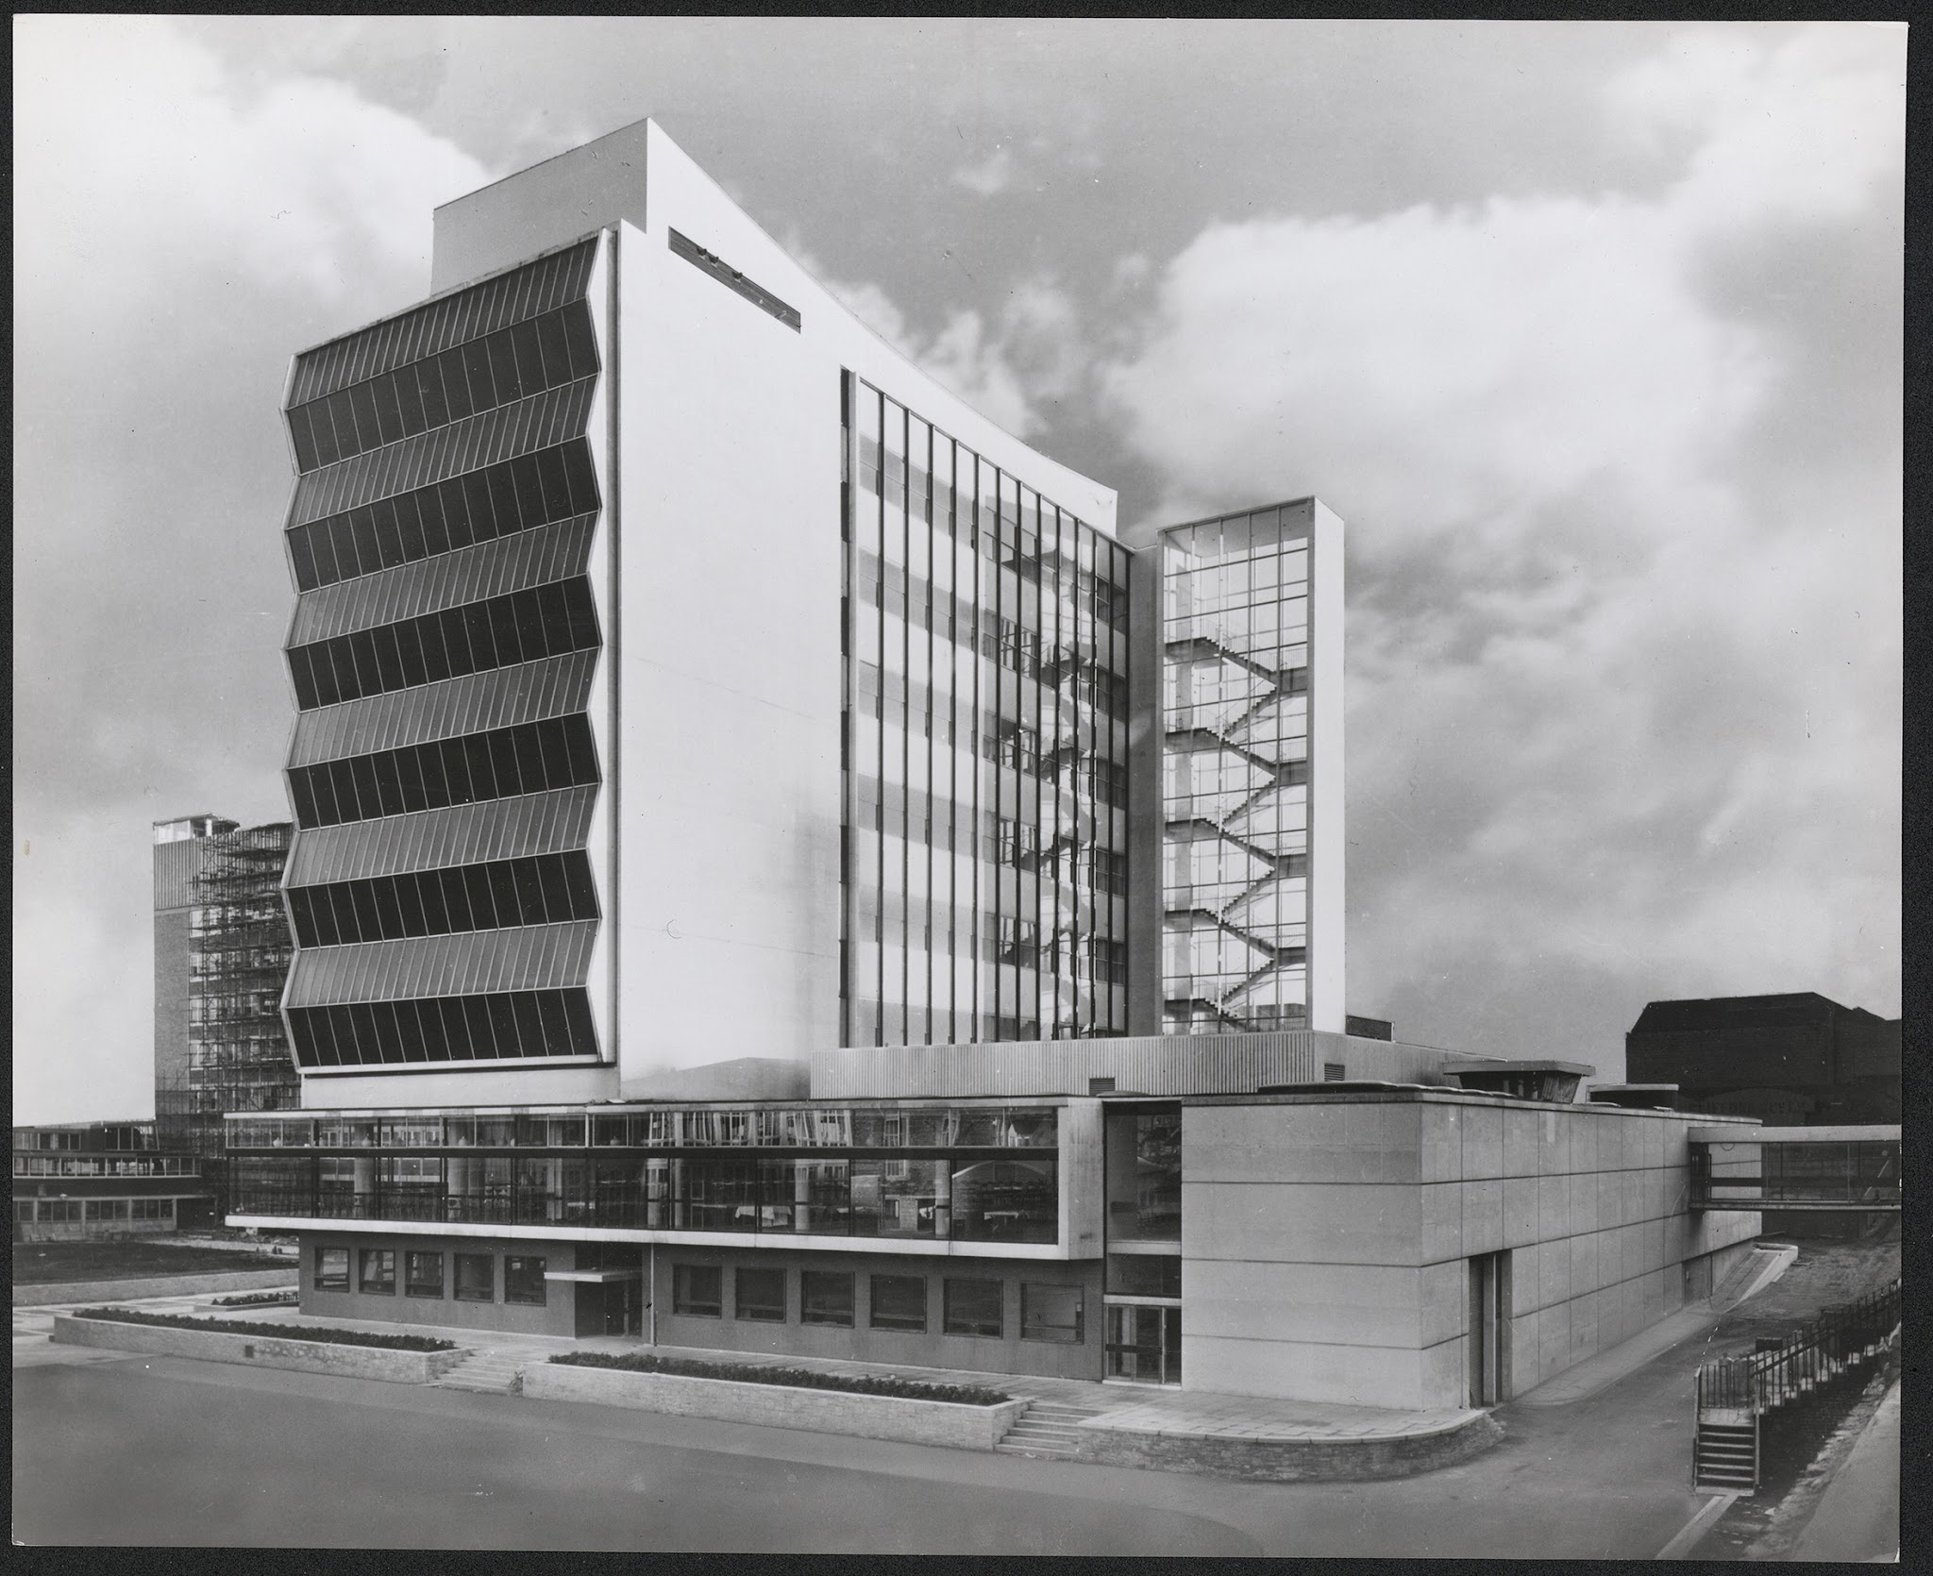
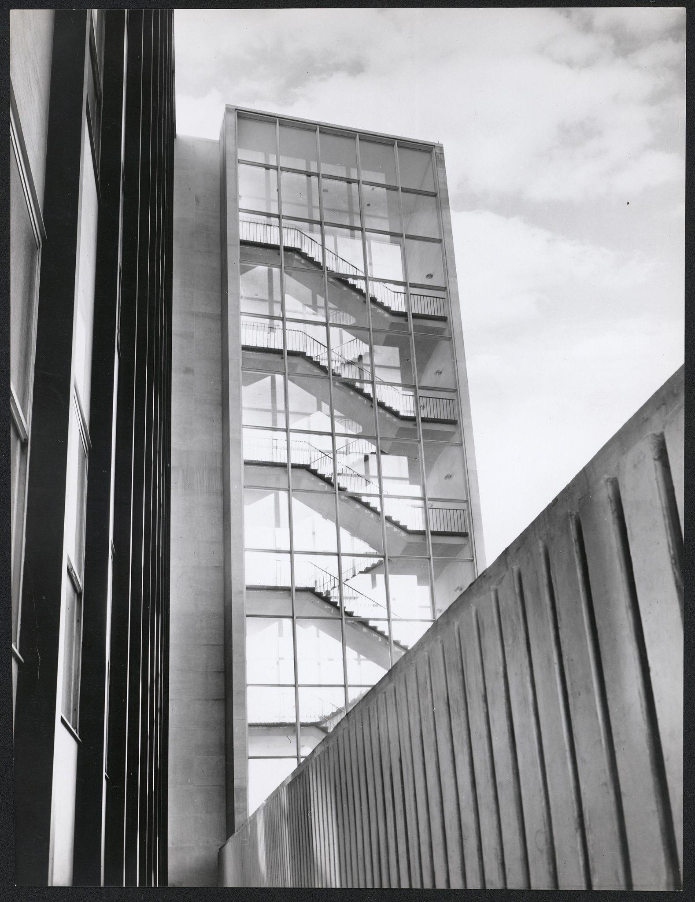
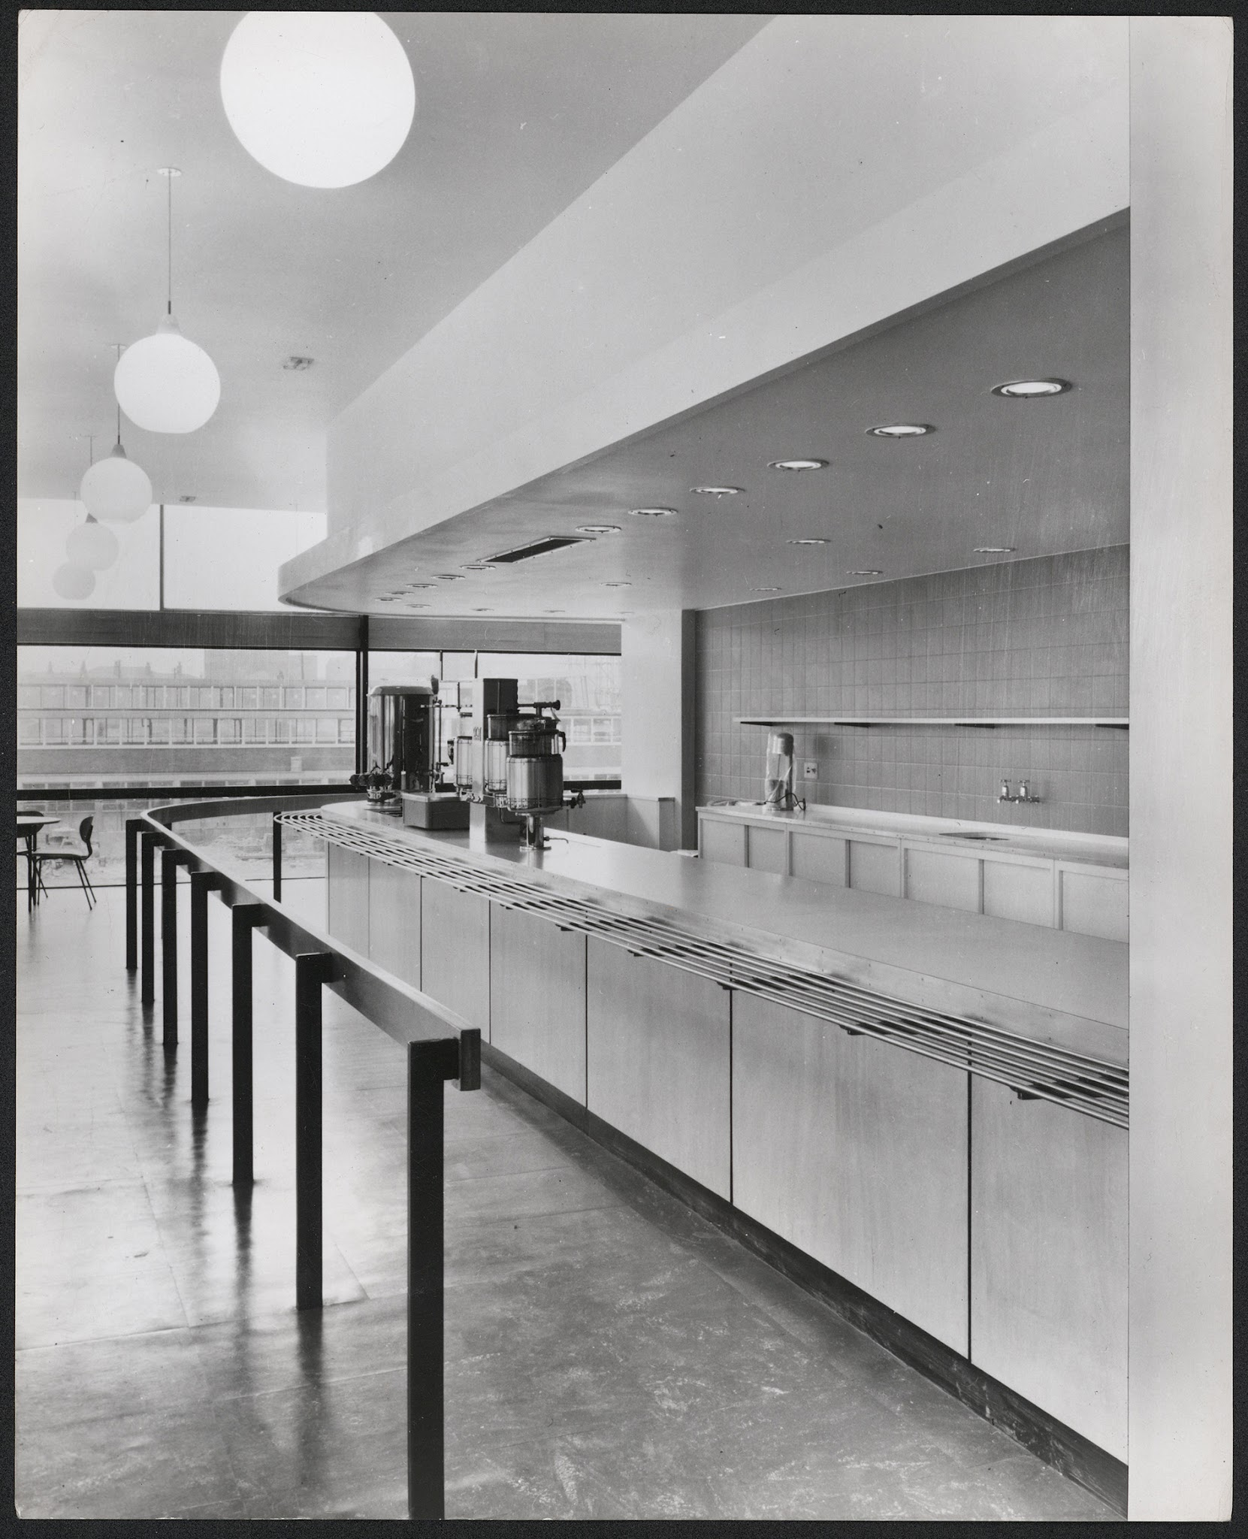
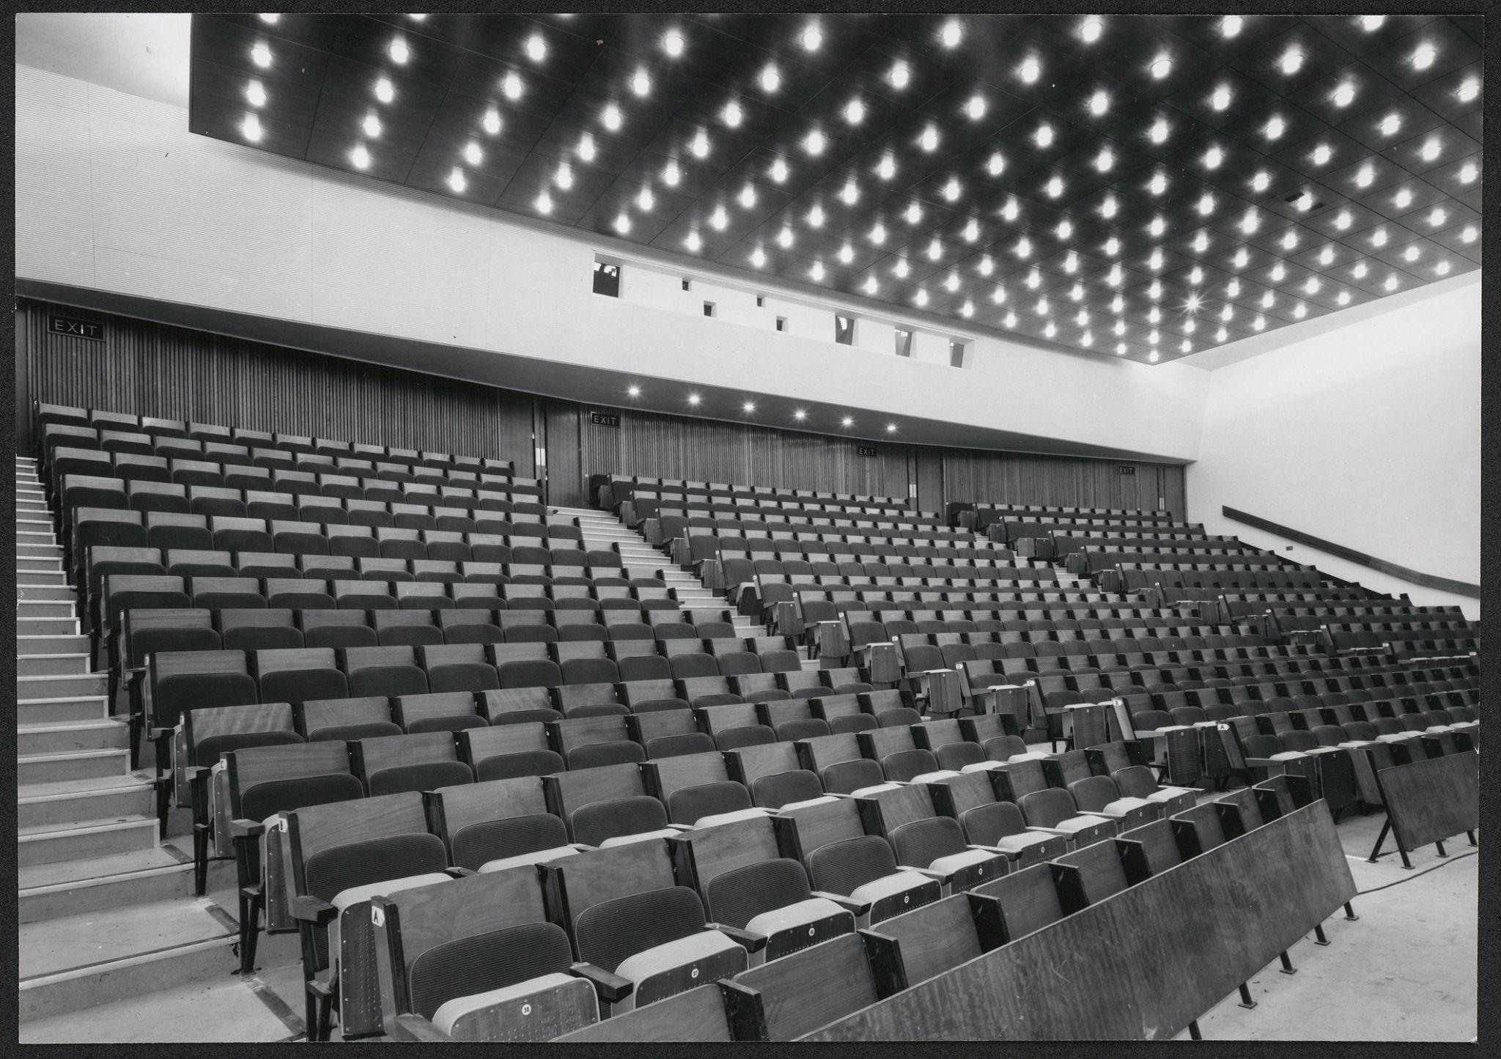

Slide 12
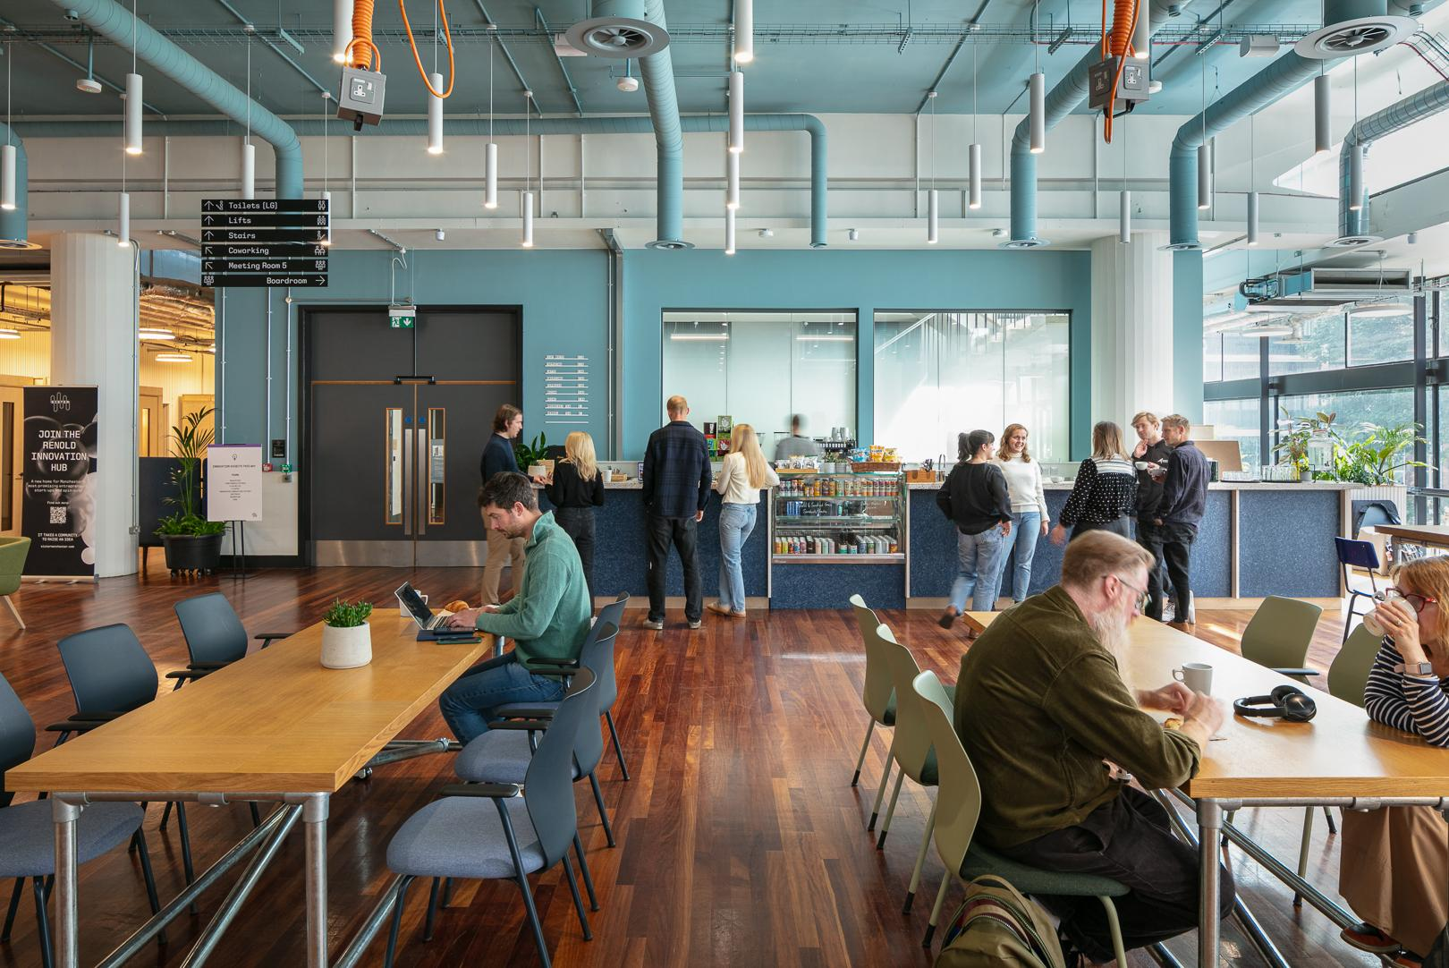
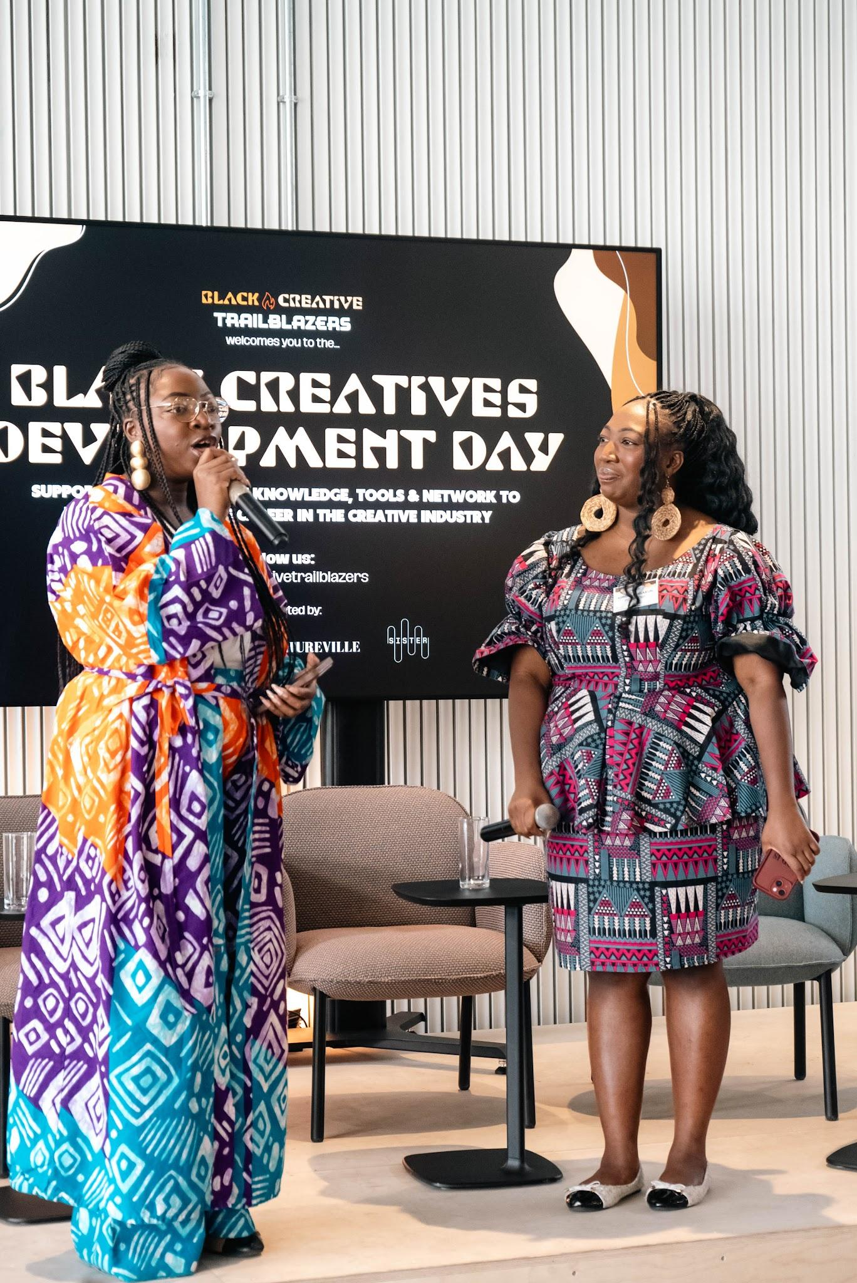
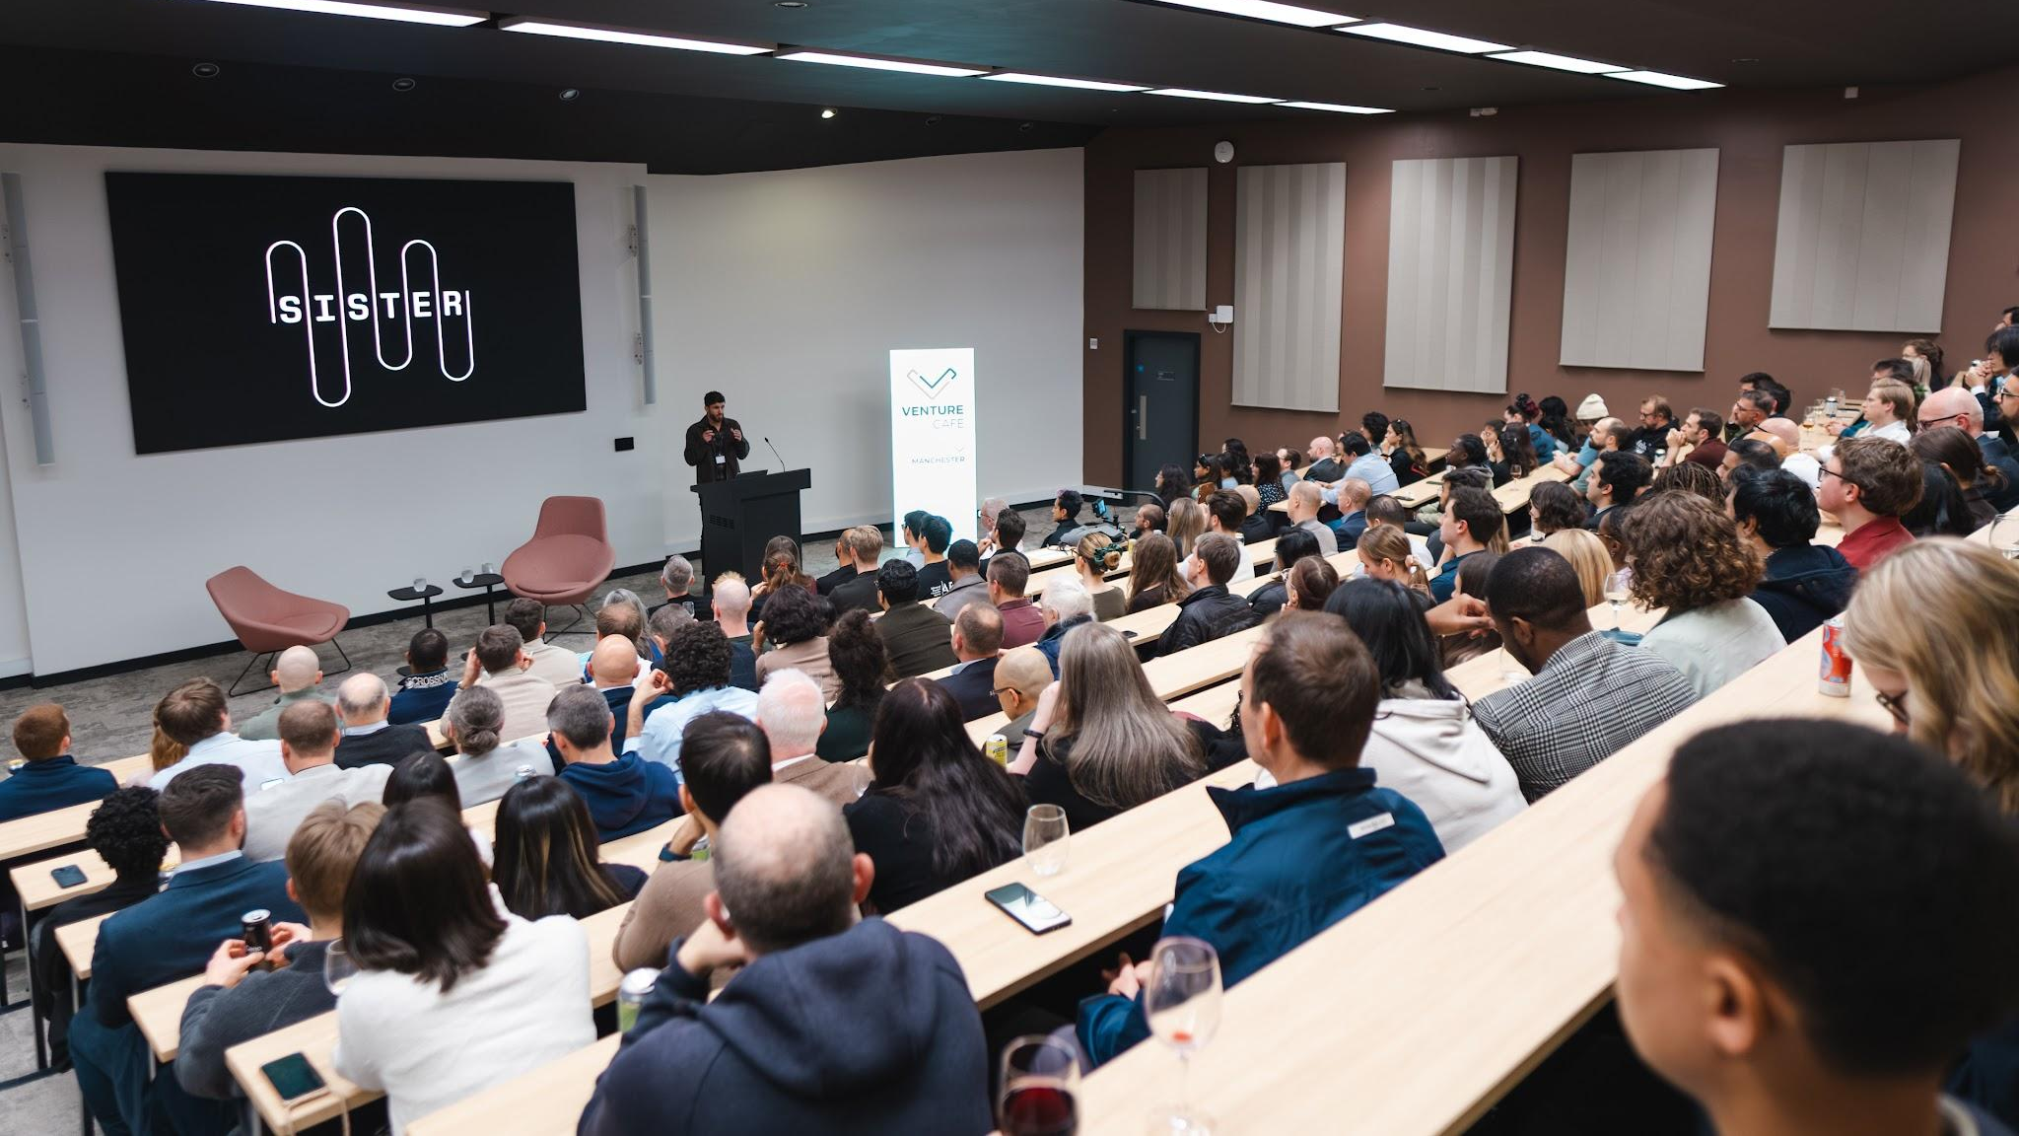
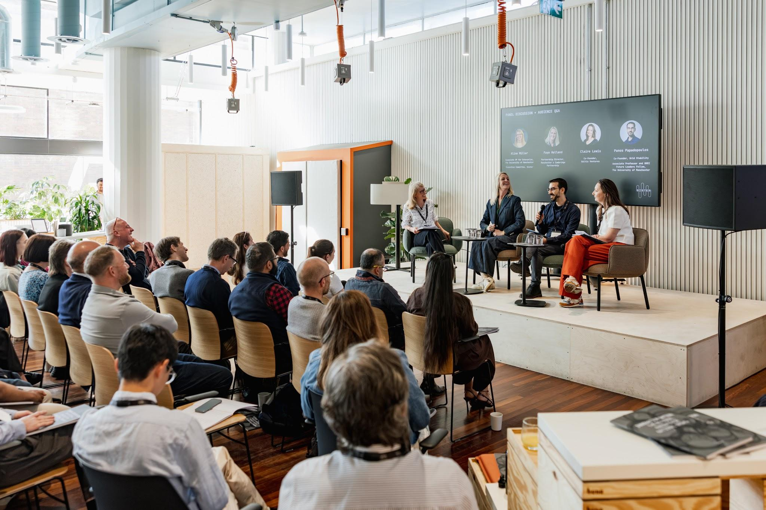
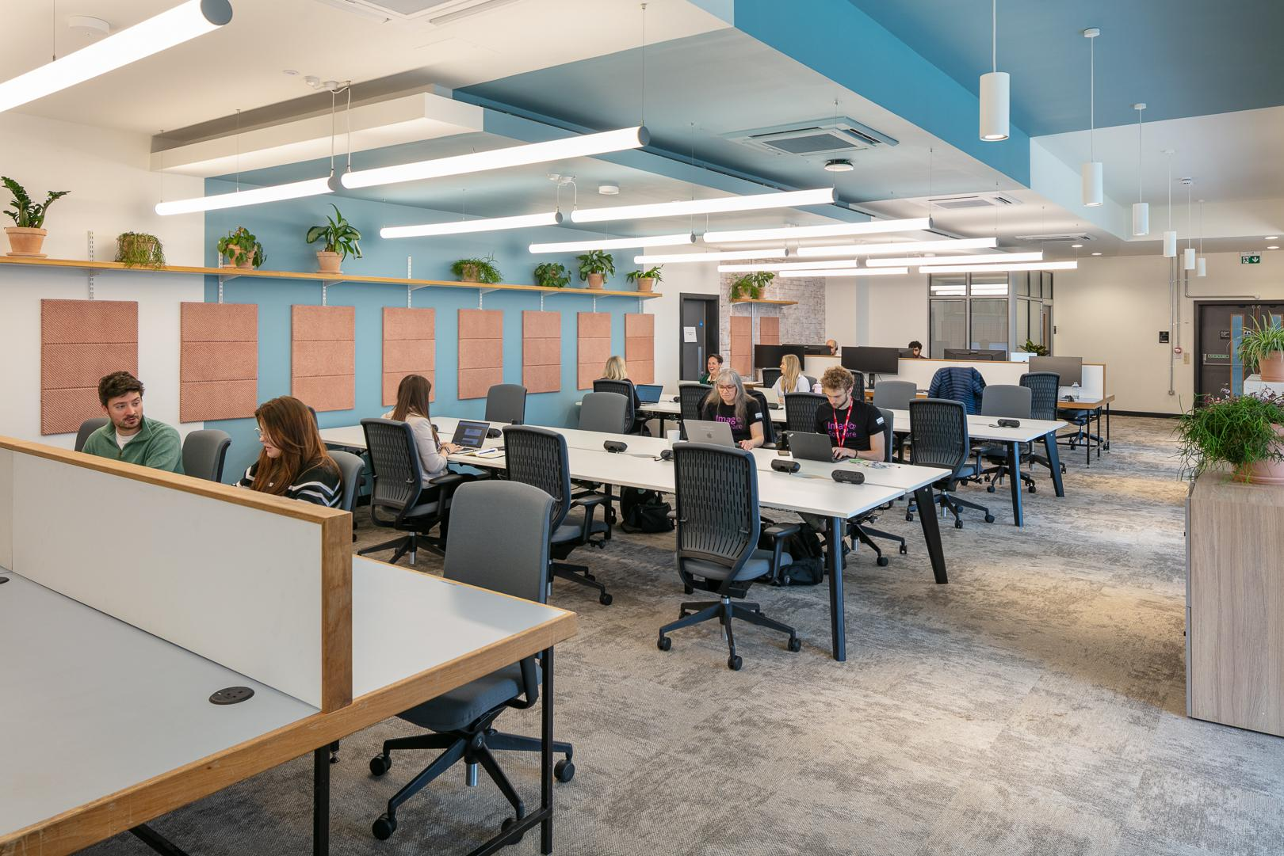
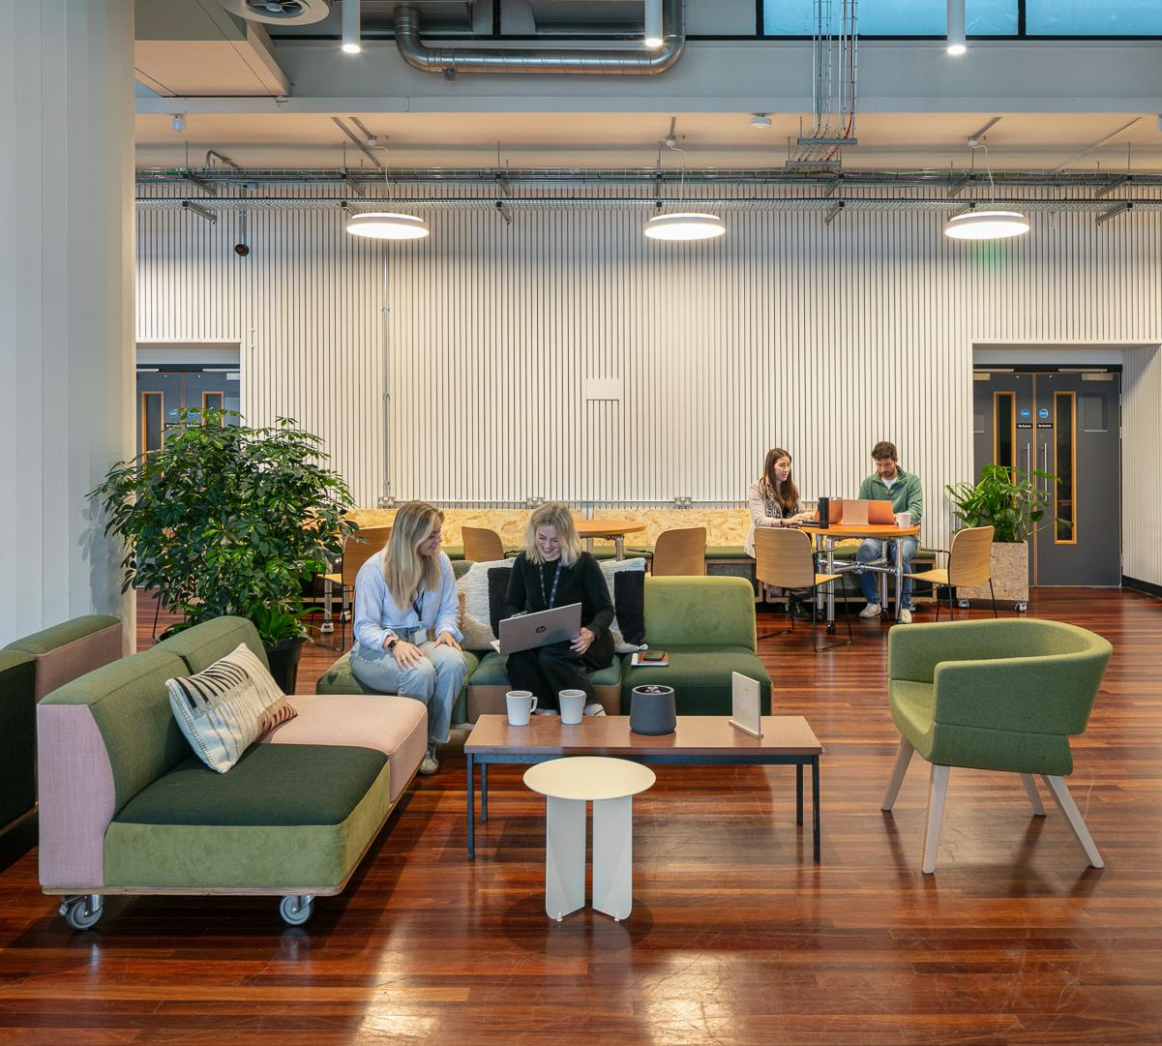

Slide 13
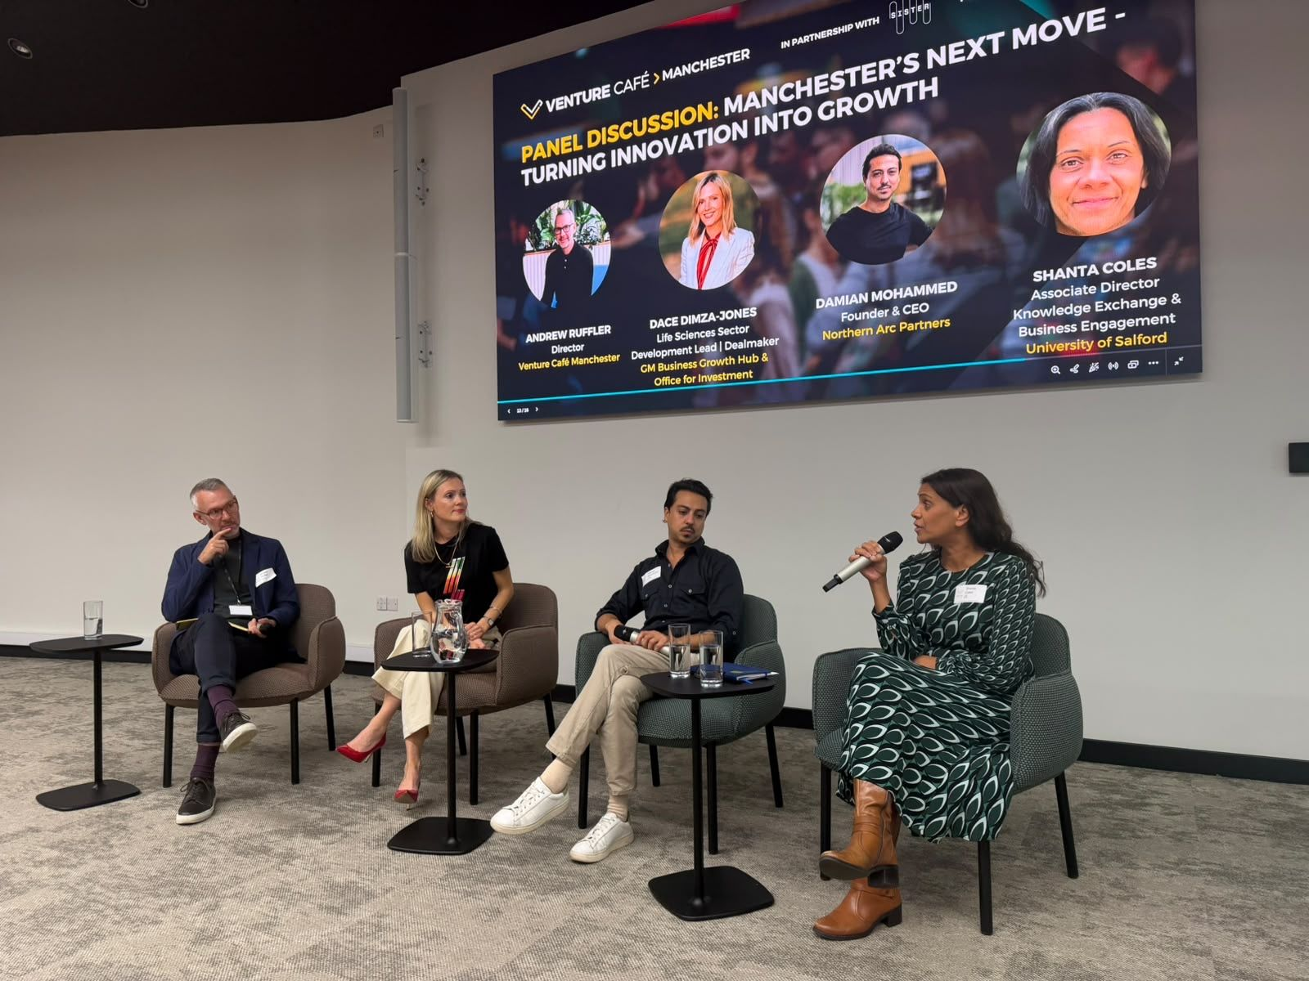
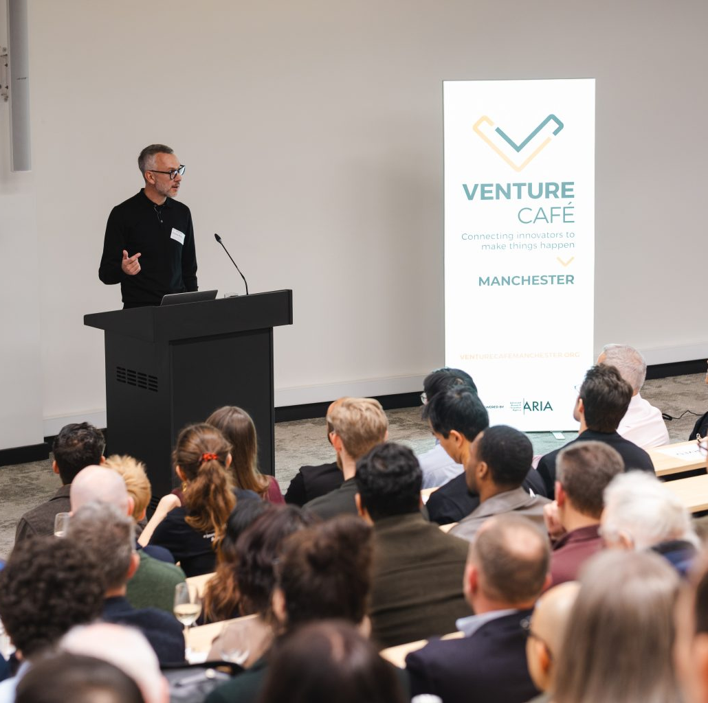
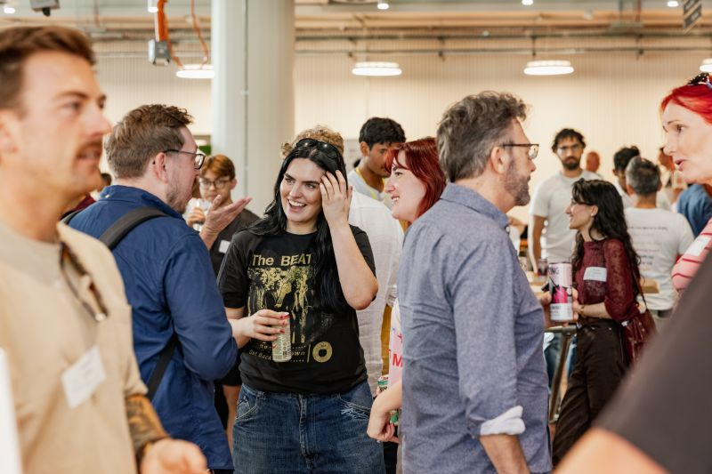

Slide 14
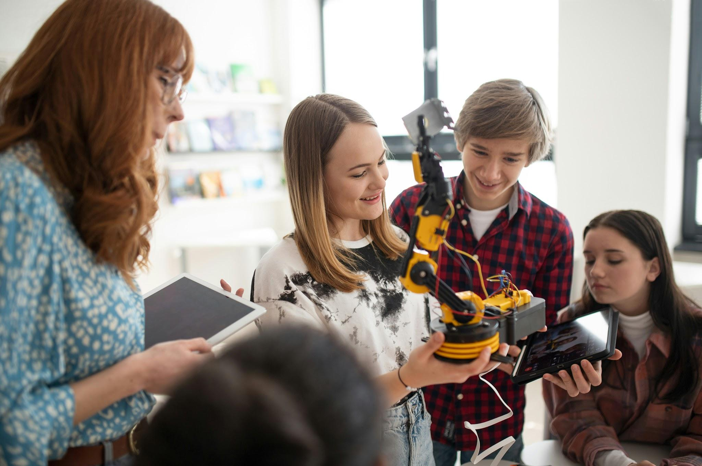


Slide 15
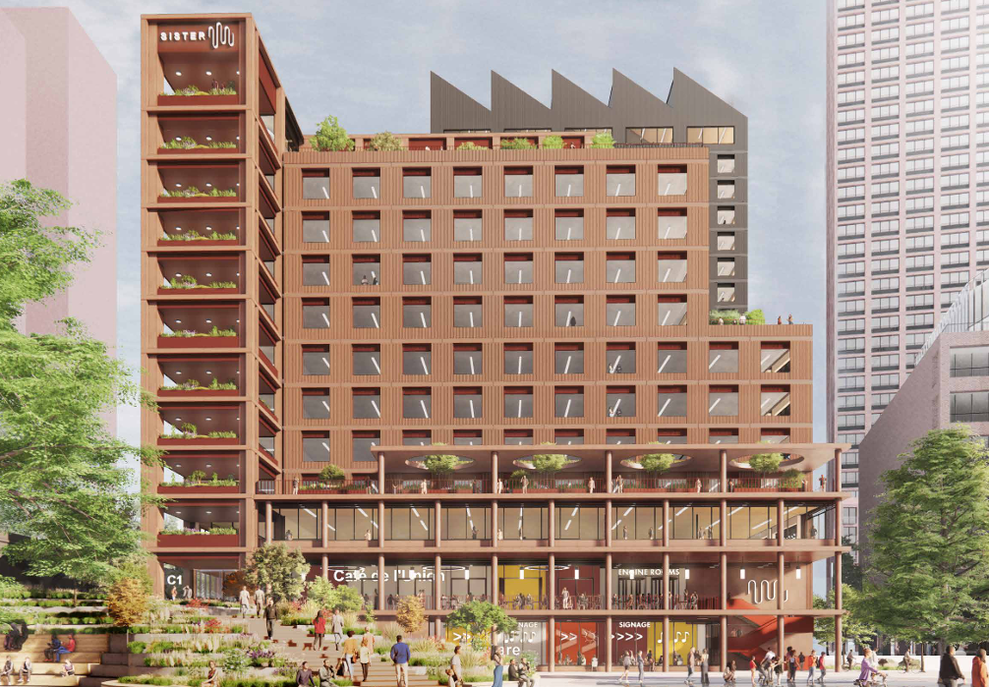
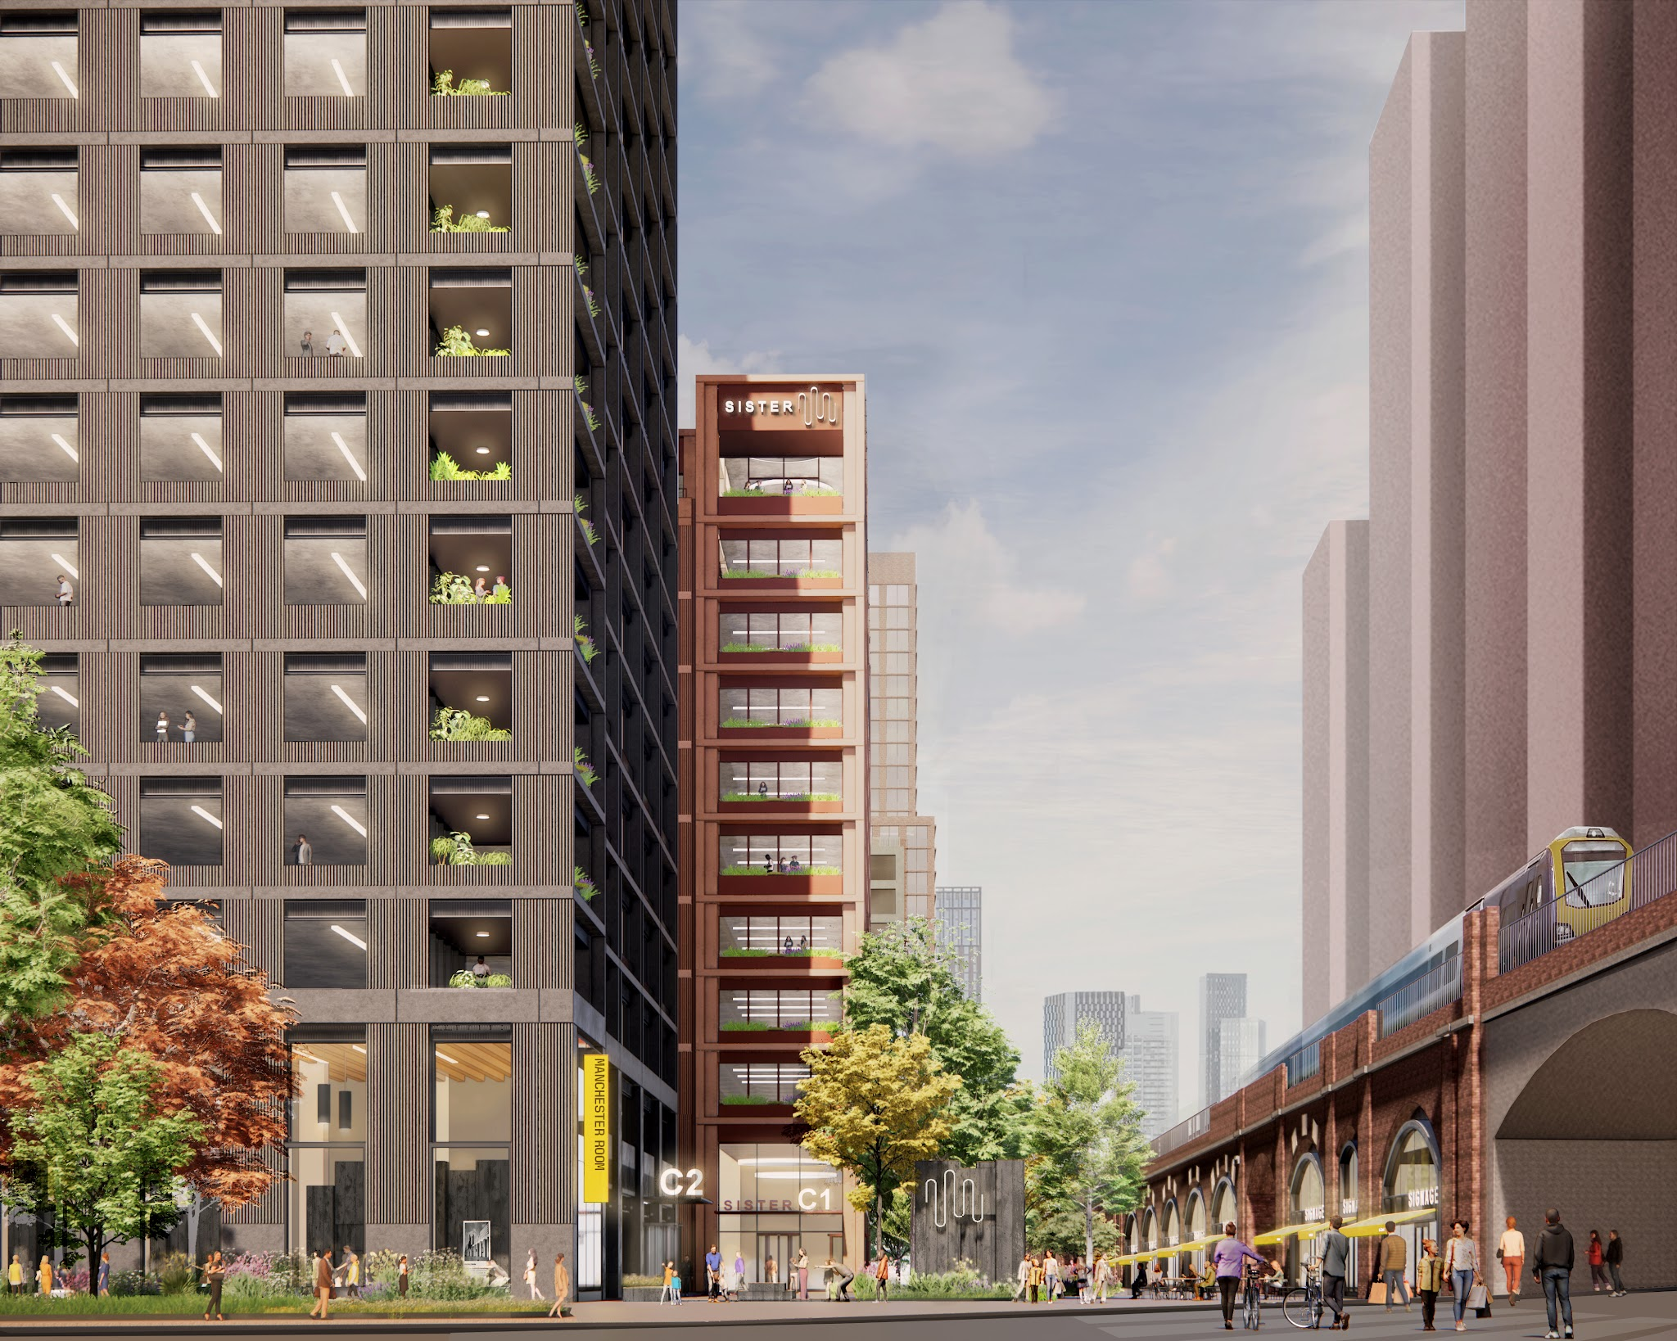
THE NEXT PHASE:
BUILDING A GLOBALLY
COMPETITIVE INNOVATION
DISTRICT
500,000 sq ft office and innovation space
A new public square
Creating a high-functioning regional cluster
Supported by regional funding
Landing space for large global organisations
A launch pad for local, growing start-ups and spin-outs

Slide 16
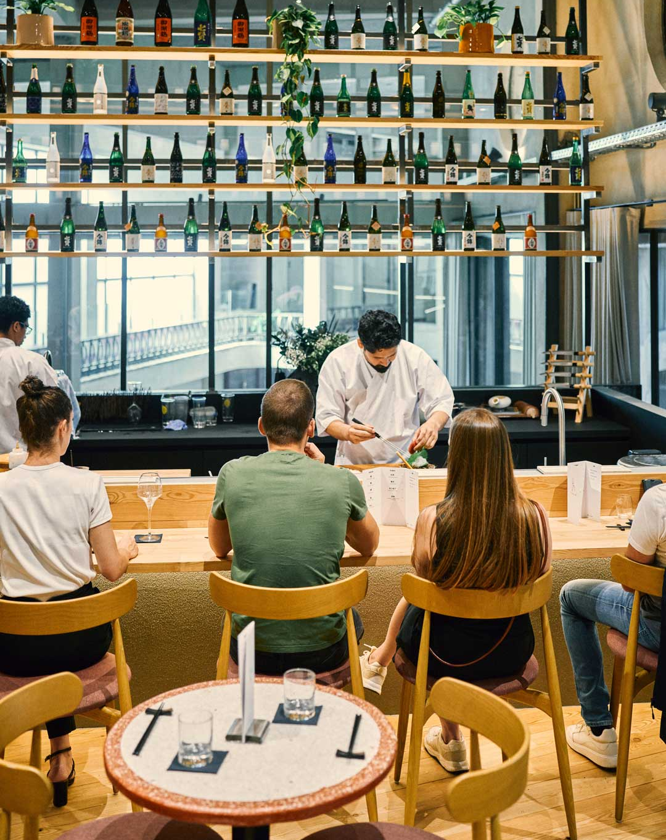
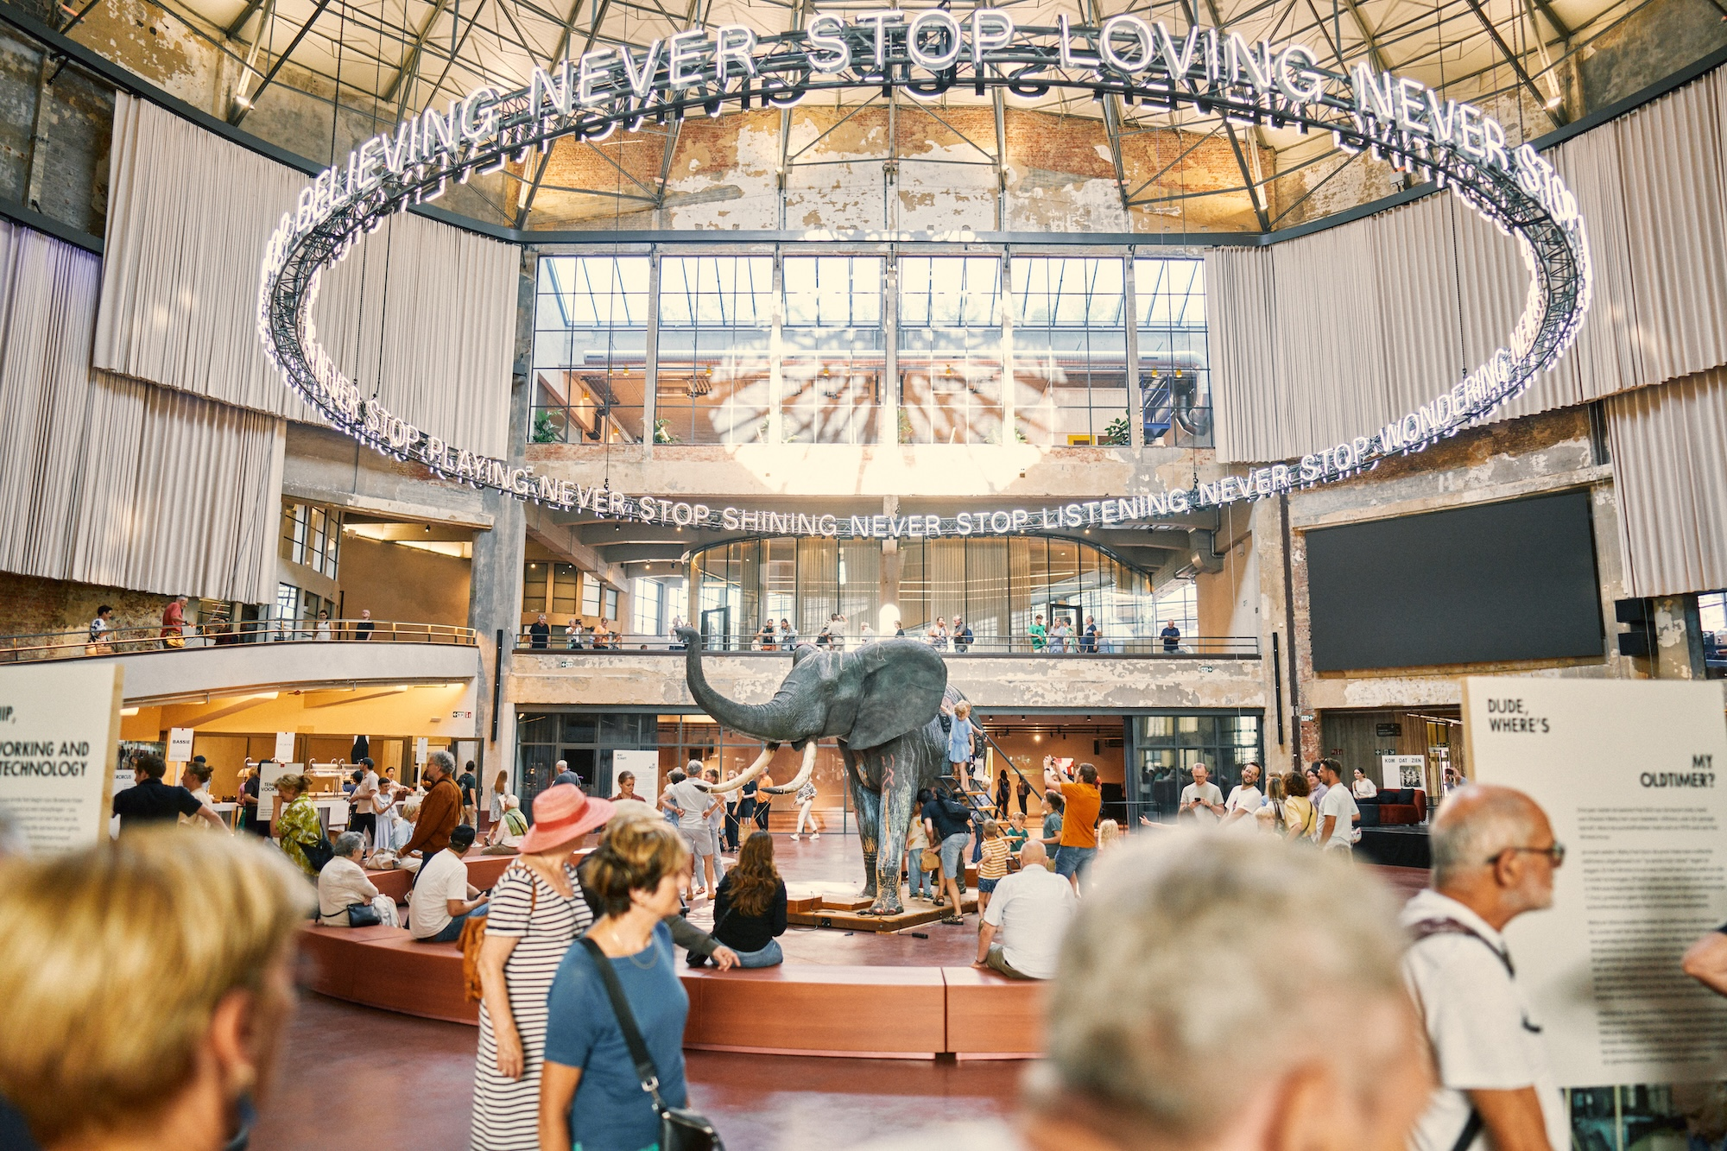
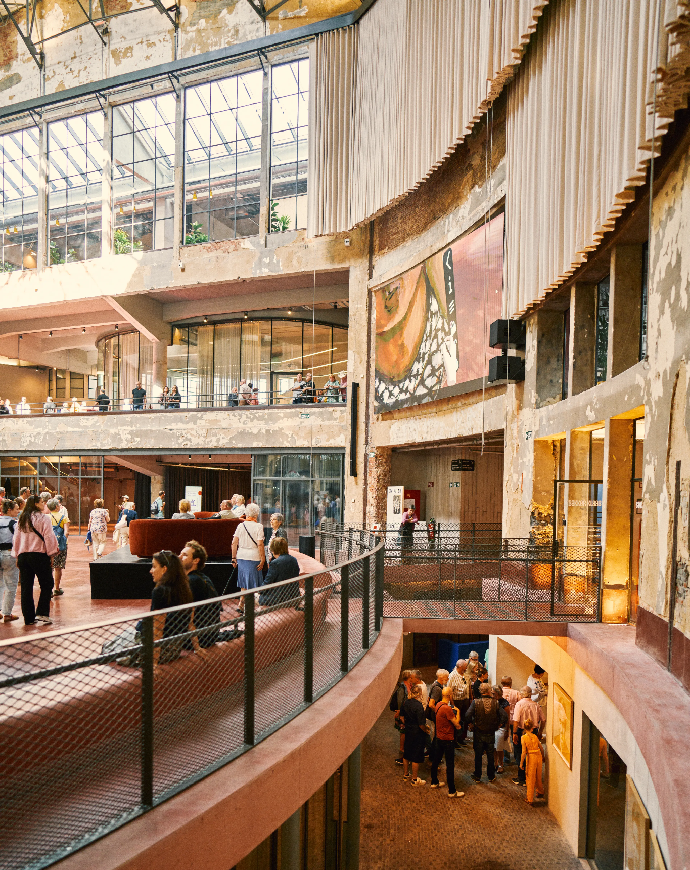
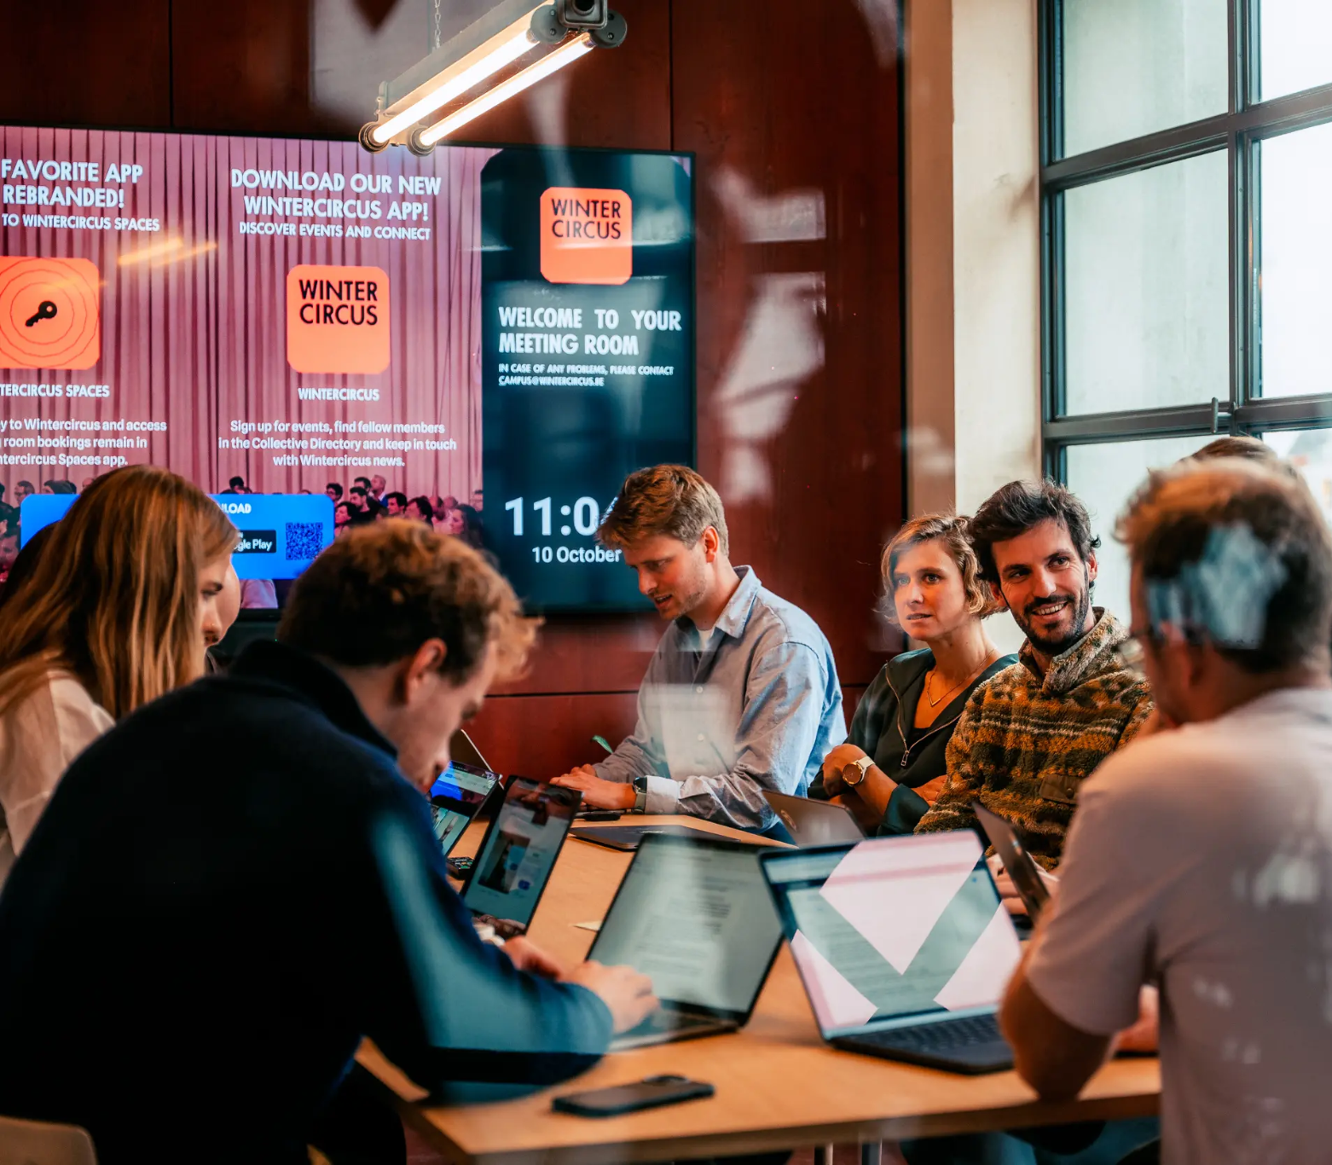
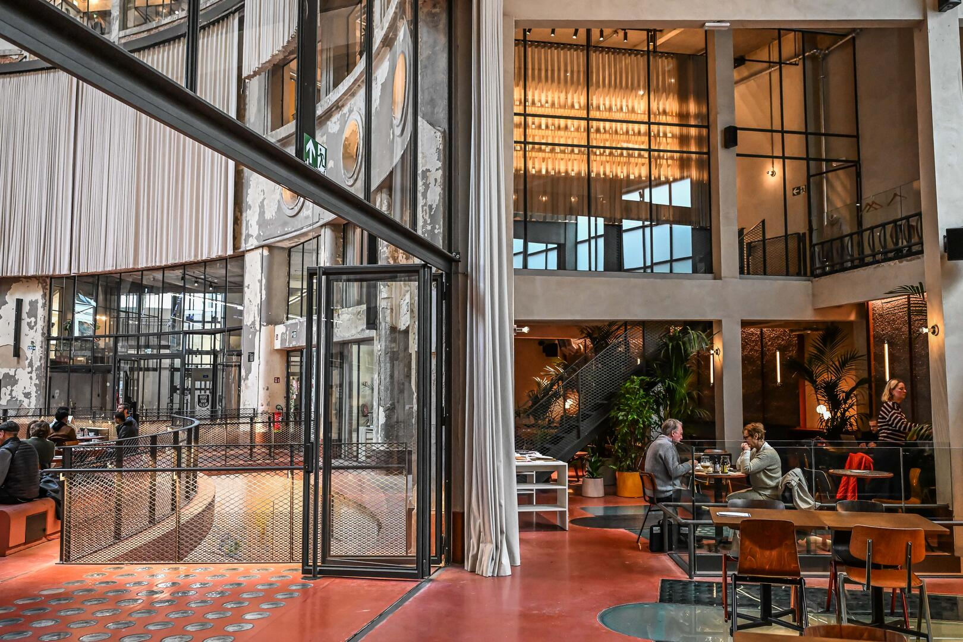
USE THE PAST TO BUILD THE FUTURE

Slide 18
THANK YOU

